Slide 1
Purchase Return to Vendor

Slide 2
Our example of Customer – Vendor ?
I have Finsys ERP
Name = Akito Kowa Packaging Ltd
Make Flexible Packaging in NCR Delhi
My vendor sends 100kg Cutting oil for Machines @ 1100/kg
We reject part of the shipment, And return 1 drum, 30 kg @ Rs 1100/kg

Slide 3
Pre GST
We used to make a Purchase Return invoice
This was as per Excise Rules

Slide 4
Post GST : What people are doing ?
Method 1 :
  Make a Delivery Challan
  Ask for vendors’ Credit Note
Method 2 :
  Make a Purchase Return Invoice
  And charge him Value + taxes

Slide 5

Now in Detail

Slide 6
Law
There is no section on “Purchase return” in the law.
There is no notification / Circular on “Purchase returns”

Slide 7
Sale : 1 lakh,
Purchase return invoice : Rs 5000
Benefits
  My books are correct, Vendor account is debited immediately.
  No risk of excess payment to Vendor

Slide 8
Benefit no 2
  E way bill /
  Document for the “road” movement
  no Risk on the Road

Slide 9
Benefit 3 : Vendor Reconciliation
No risk of goods sent,
  But Debit Note not made.
No risk of goods sent,
  Debit Note not sent by courier. Lost on the way.
  Reco problems
No risk of vendor denying, I don’t know, I don’t remember.

Slide 10
Benefit 4
GSTR 1 , I am not dependent on the vendor.
I debit him straight away. I charge him the basic and the tax on that. In GSTR-1, I show this as my outward supply.
He accepts in GSTR-2.
Cycle is complete
So, easy since GSTR2 is automatically made

Slide 11
Benefit 2
Government gets the GST,
and no need to reconcile the Delivery Challans and Debit Notes / reversals.
Simplification during the excise audit after some years

Slide 12

Case 2 : Credit Notes

Slide 13
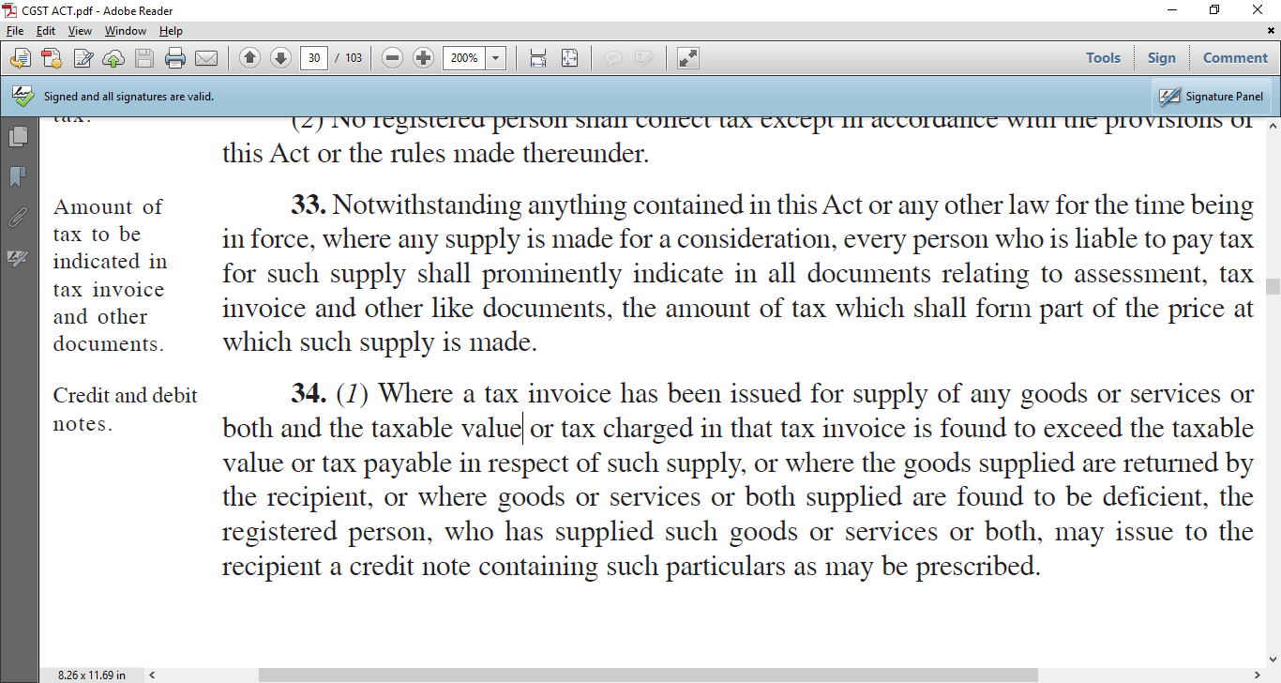
Section 34(1) Credit Note .. PTO

Slide 14
Conditions in Section 34
34. (1) Where a tax invoice has been issued for supply of any goods or services or both and
the taxable value or tax charged in that tax invoice is found to exceed the taxable value or tax payable in respect of such supply, or
where the goods supplied are returned by the recipient, or
where goods or services or both supplied are found to be deficient,
the registered person, who has supplied such goods or services or both,
may issue to the recipient a credit note
containing such particulars as may be prescribed.

Slide 15

How to do in Finsys ?

Slide 16
Make Delivery Challan
RGP in 22 Series
This is non returnable material

Slide 17
Make Debit Note 59 Series
This is against that Delivery Challan
But no link in ERP
So, a large risk remains,
And all the
Since Debit Notes are unlimited in variety
  Rate
  Qnty
  Calculation
  Freight

Slide 18

Now in Finsys

Slide 19
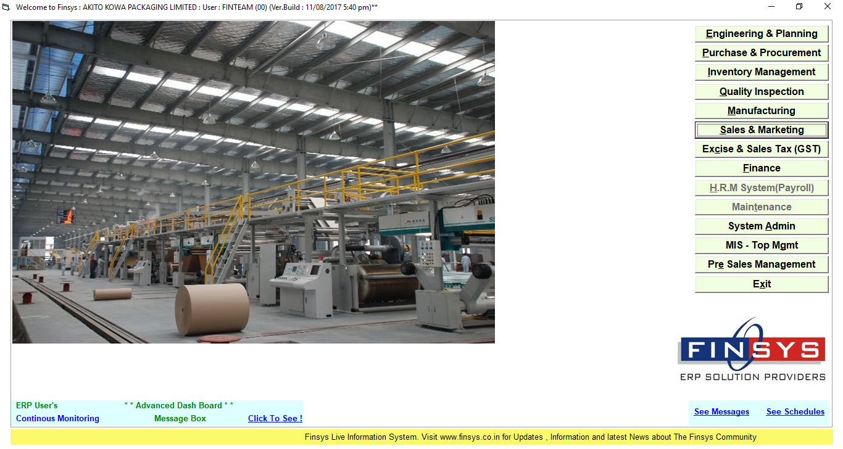
Go to Sales Module

Slide 20
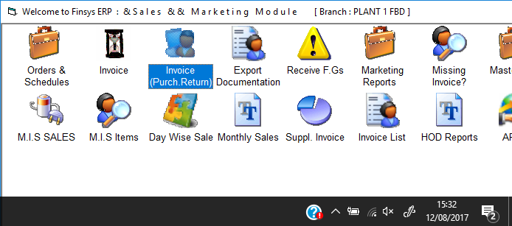
Invoice Purchase Return

Slide 21
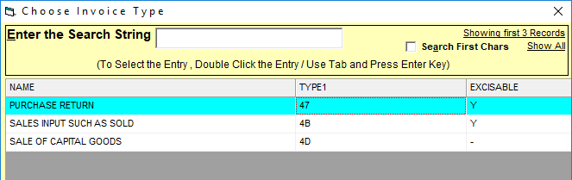
Popup select … “Purchase Return”

Slide 22
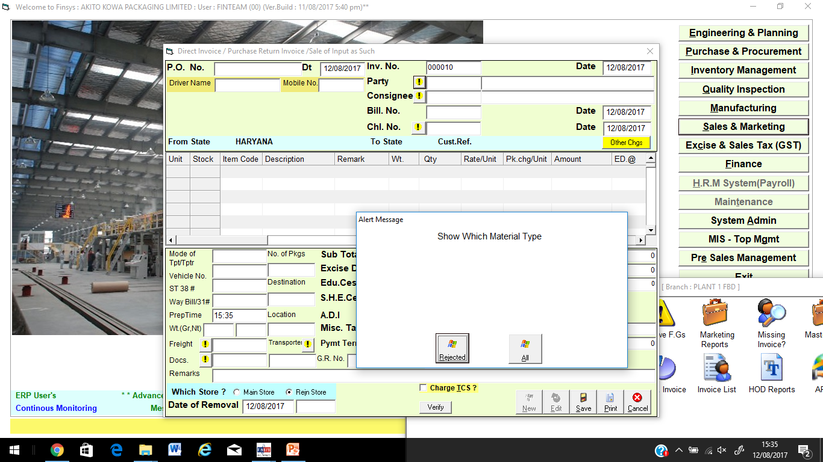
Which material, Rejected or all ?

Slide 23
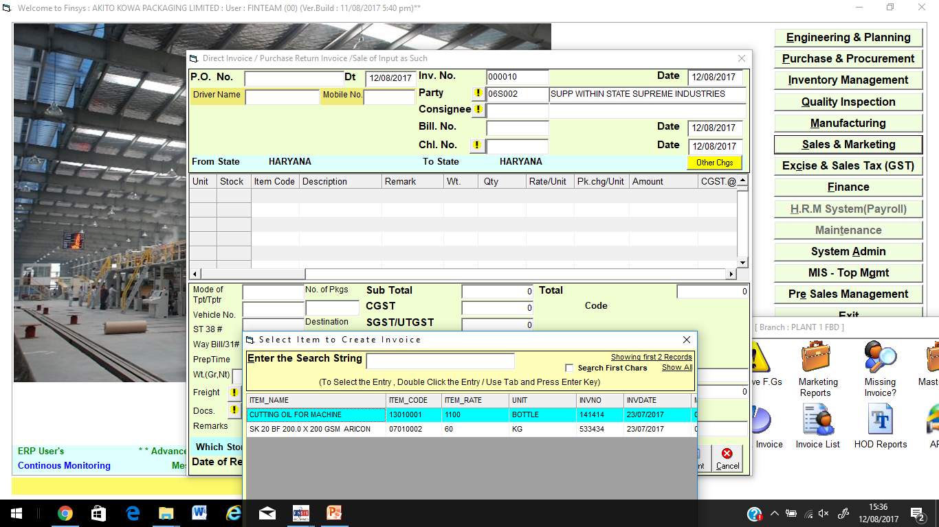
Select the item name

Slide 24
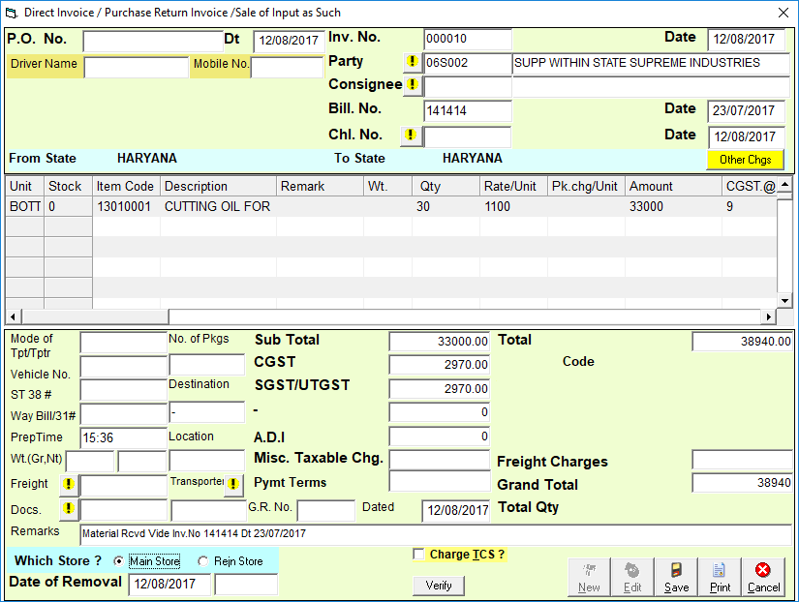
Rate is automatic,
Qnty either auto or yourself

Slide 25
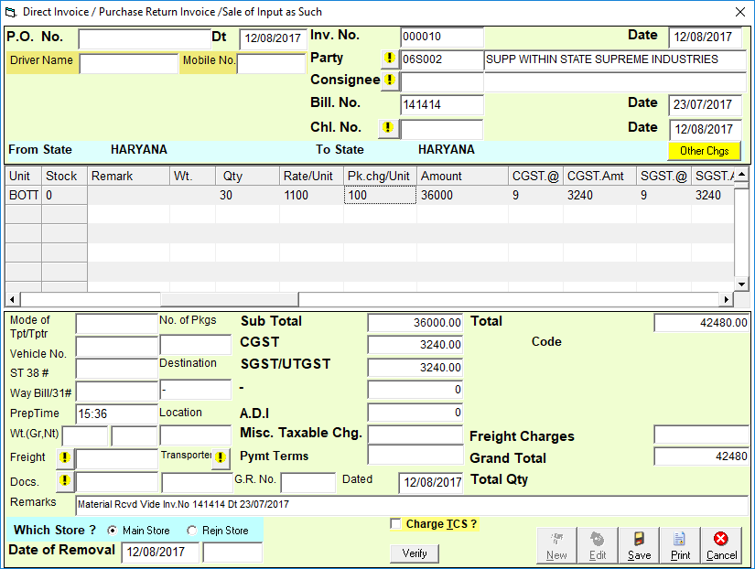
Impose Penalty / Packing Charge

Slide 26
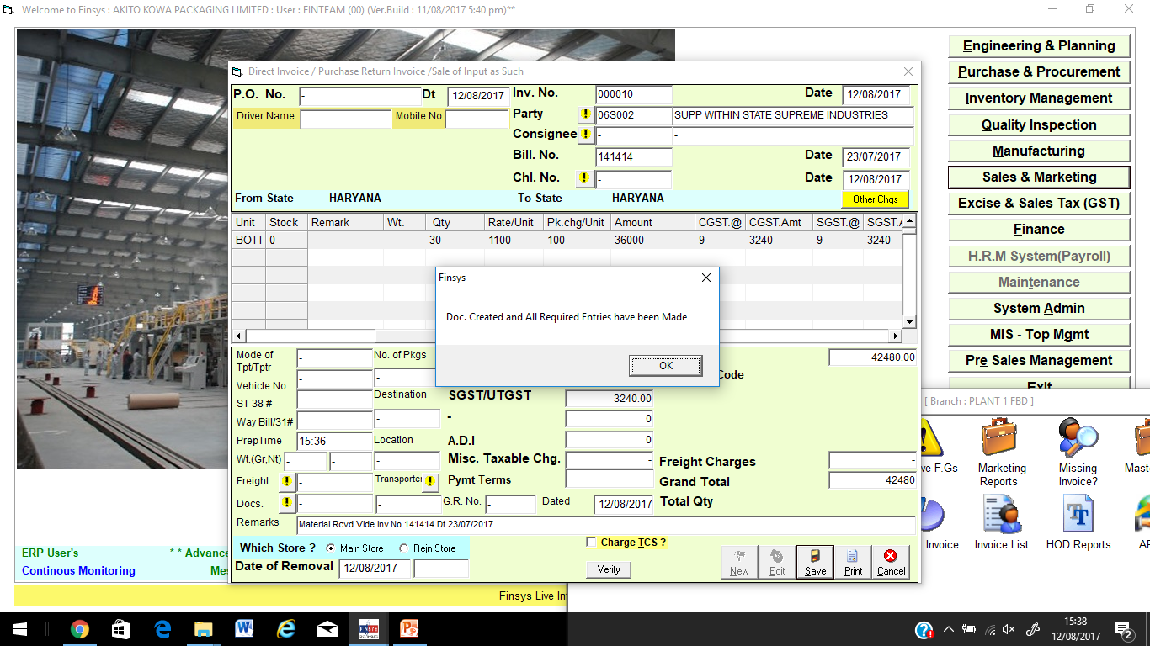
Purchase return invoice is ready

Slide 27
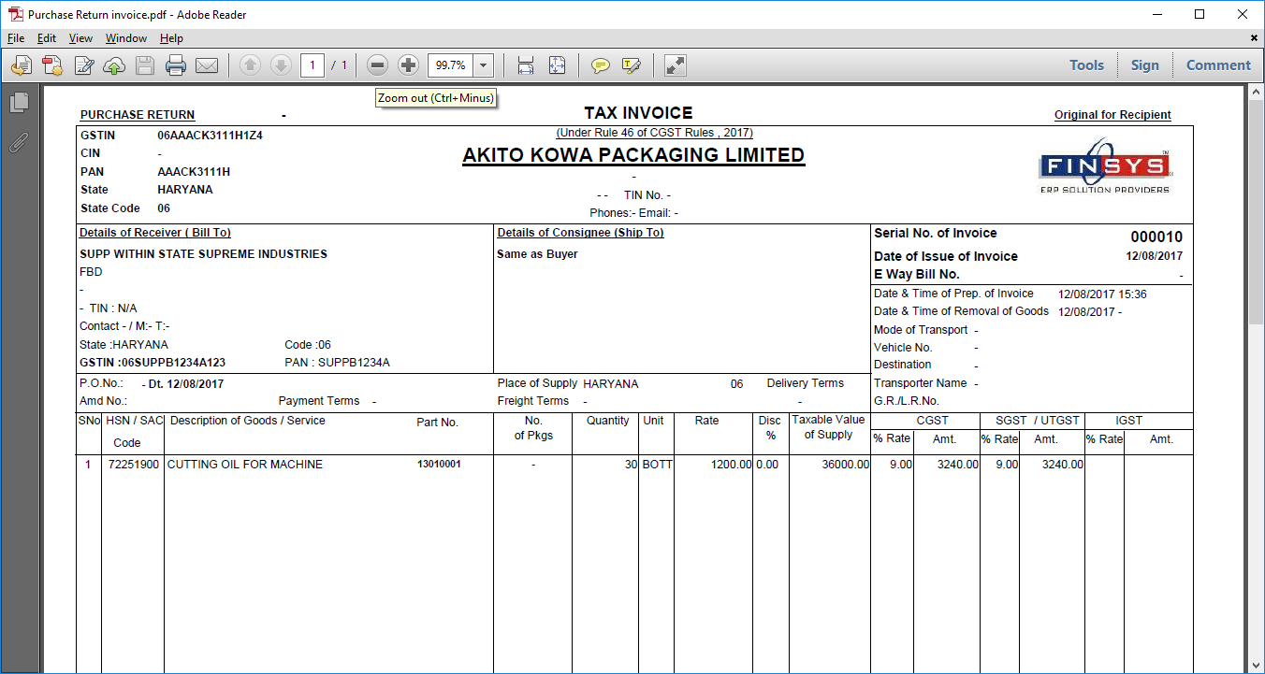
Printout of Purchase return Invoice
PTO for Closeup

Slide 28
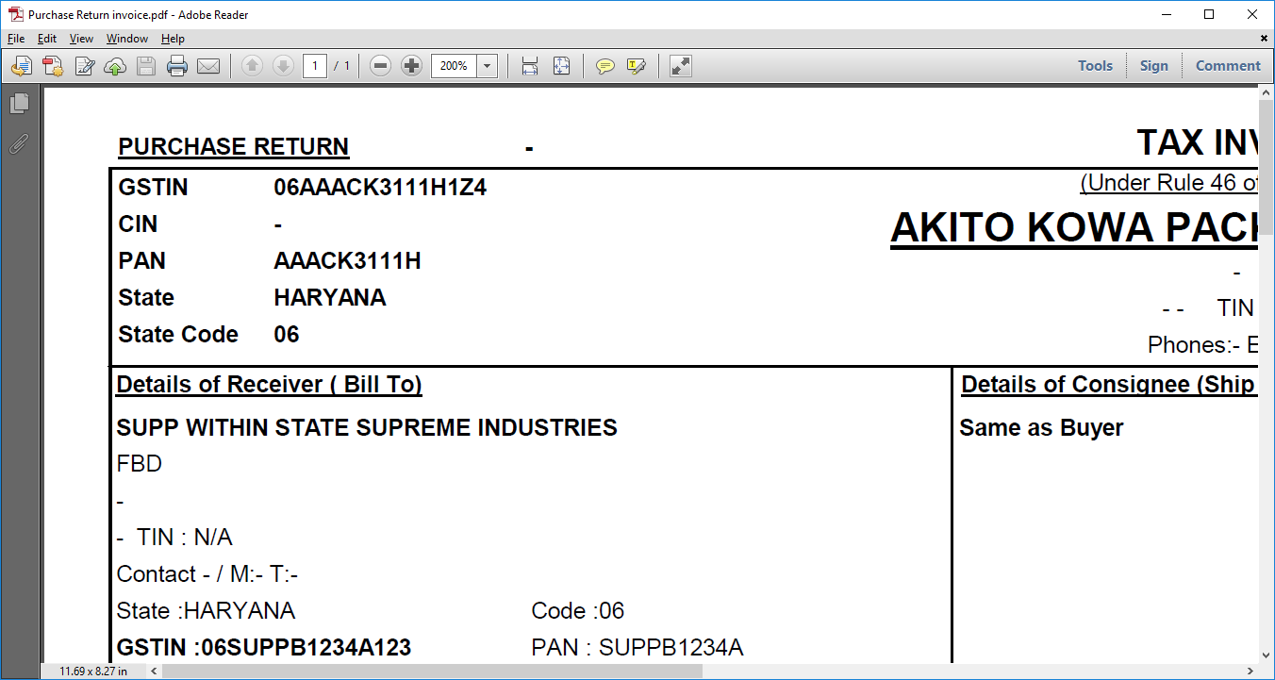
Purchase Return Title

Slide 29
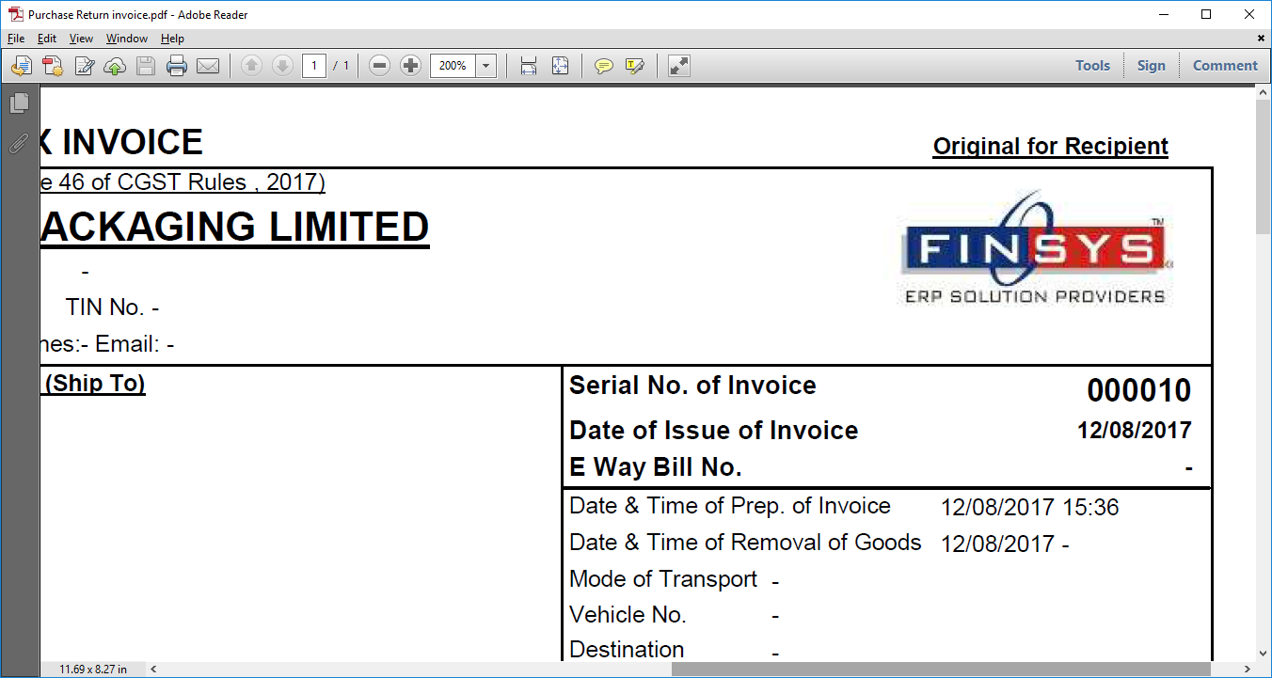
Same Invoice Series

Slide 30
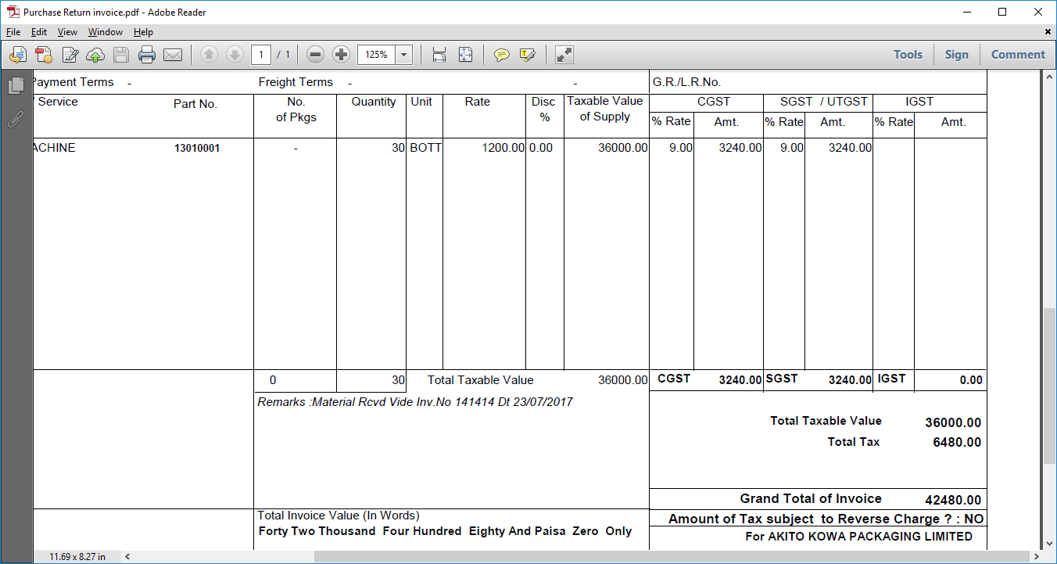
Rate as I applied ( 1100+100 packing)

Slide 31
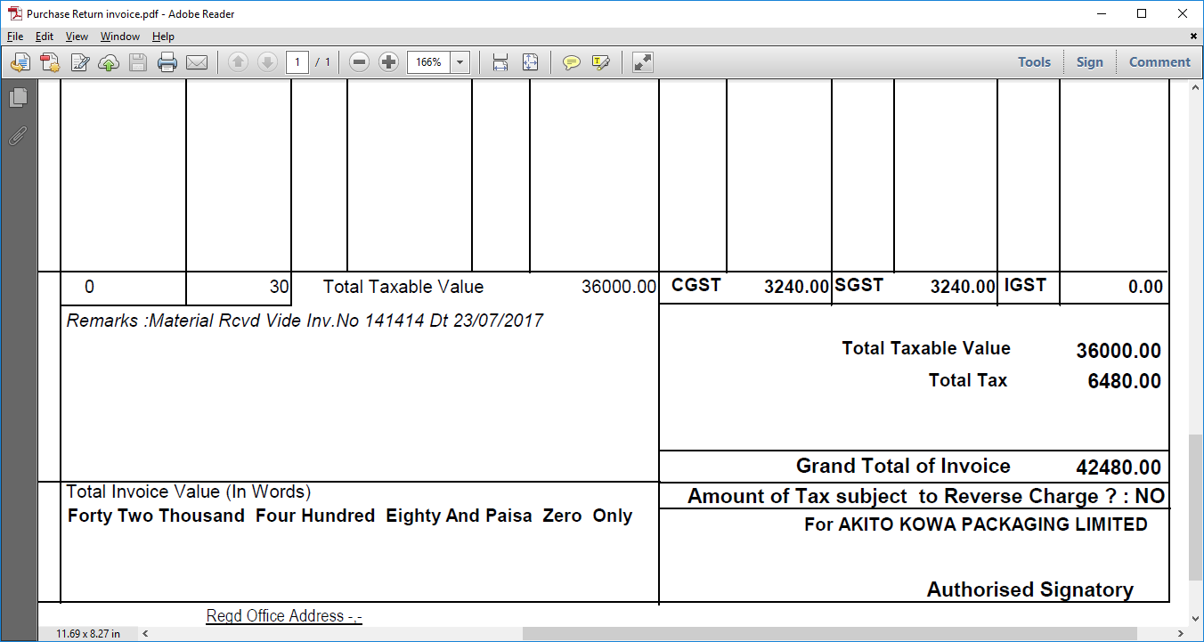
This remark is also there

Slide 32


