Slide 1
What report should we see for job worker transaction? We have some Job Worker management Reports

Slide 2
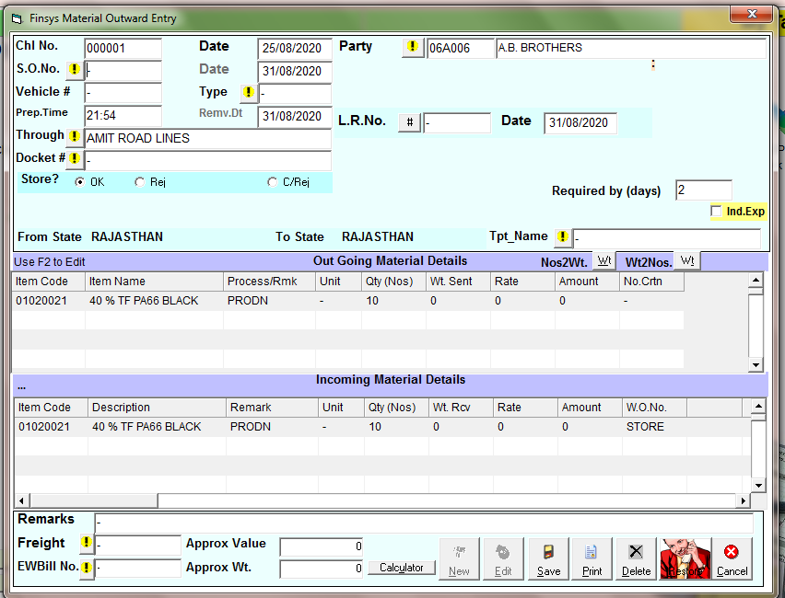
RGP Challan

Slide 3
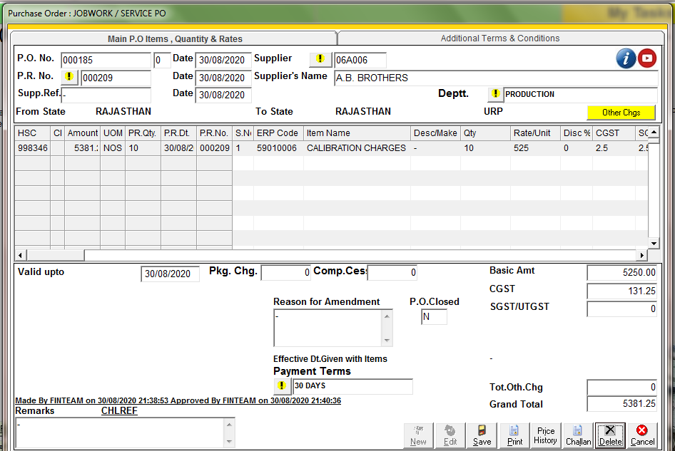
Rates and authority to send, connected to Job Work Purchase order

Slide 4
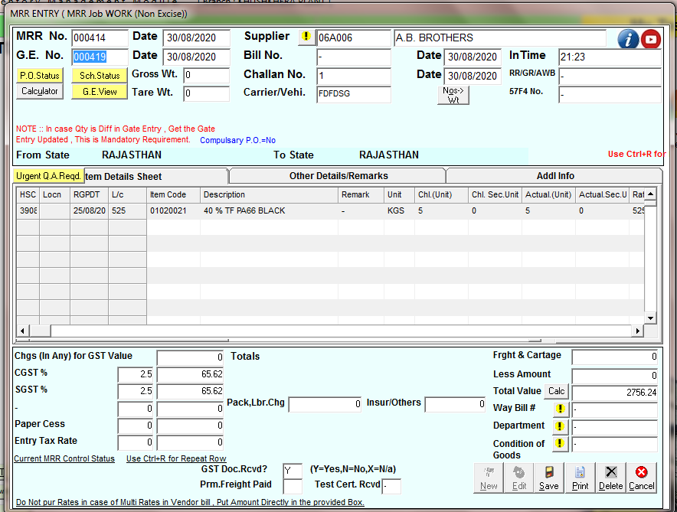
Job Workers for your company – Assets or Equipment going on RGP and coming back on MRR & Reconciliation

Slide 5
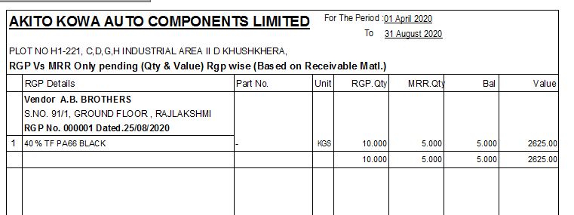
Closing stock Quantity, and its valuations

Slide 6
Item Wise Status

Slide 7
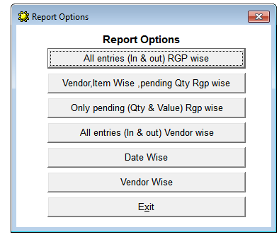
Job Work Ledger With Qty

Slide 8
All Entry (In and Out RGP Wise)

Slide 9
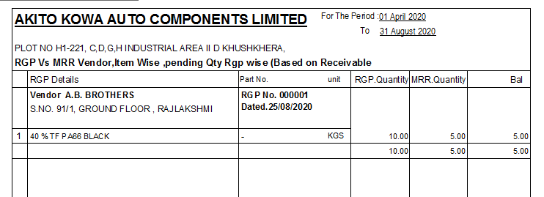
Vendor, Item Wise, Pending Qty Rgp Wise

Slide 10
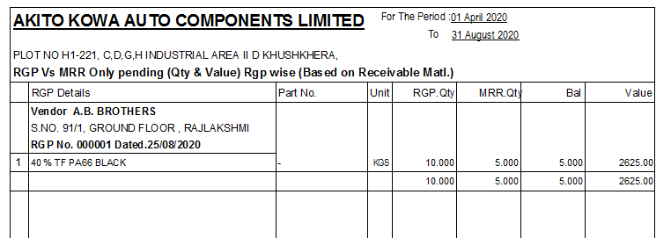
Only Pending Qty RGP Wise

Slide 11
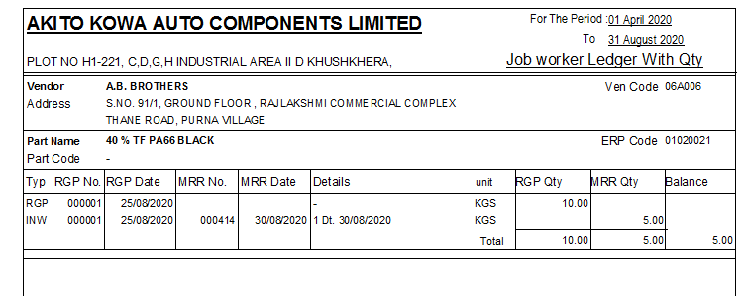
All Entry (In & Out) Vendor Wise

Slide 12
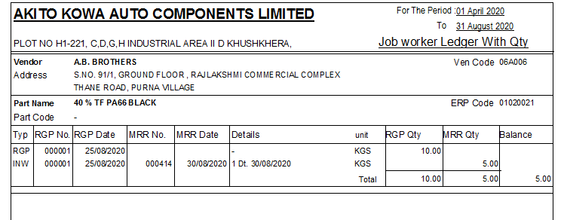
Date Wise

Slide 13
Vendor Wise

