Slide 1
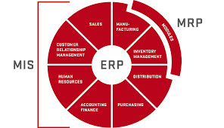
MRP Concept for Machinery Manufacturers

Slide 2
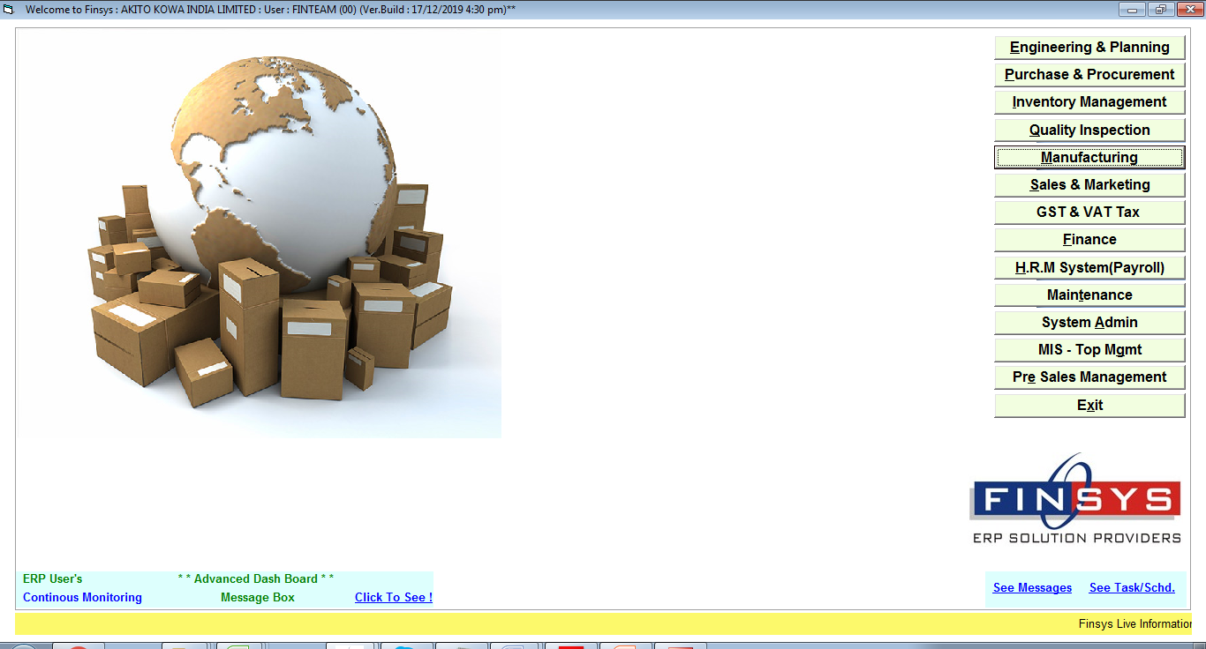

Slide 3
Material Requirement Planning
One of the Best MRP Technologies in the WORLD
Saves MONEY
reduces Purchases
reduces Cost, increases Profit

Slide 4
Material Requirement Planning
this is MRP 2020 Model
this considers
BOM,Sales orders, Lead Time,
PR / PO / QC / MIT

Slide 5
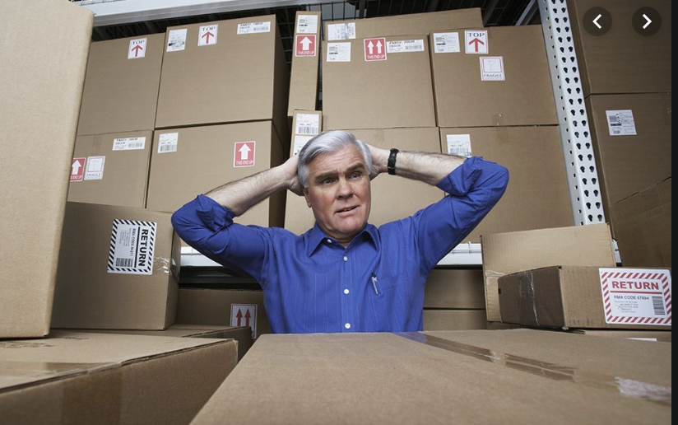
Everybody wants to Reduce Stress due to High Costs, and Work Pressures

Slide 6
Finsys MRP Module is going to Make your Life Easy We PROMISE That

Slide 7
Benefits are as Good as you if discovered hidden GOLD in your company We Assure That

Slide 8
Press MRP Icon

Slide 9
Let us See Some Bill Of Materials in this demo

Slide 10
Bill Of Material for Vision Reader Machine

Slide 11
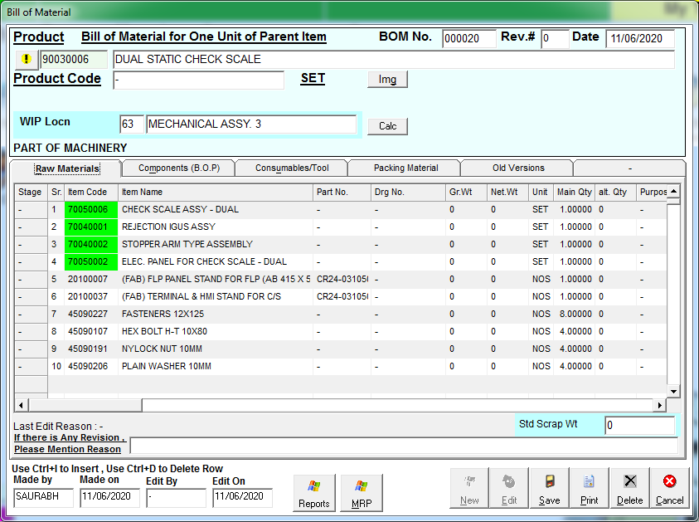
Bill Of Material for Dual Static Check Scale Machine

Slide 12
Let us See Some Sales Orders in this demo

Slide 13
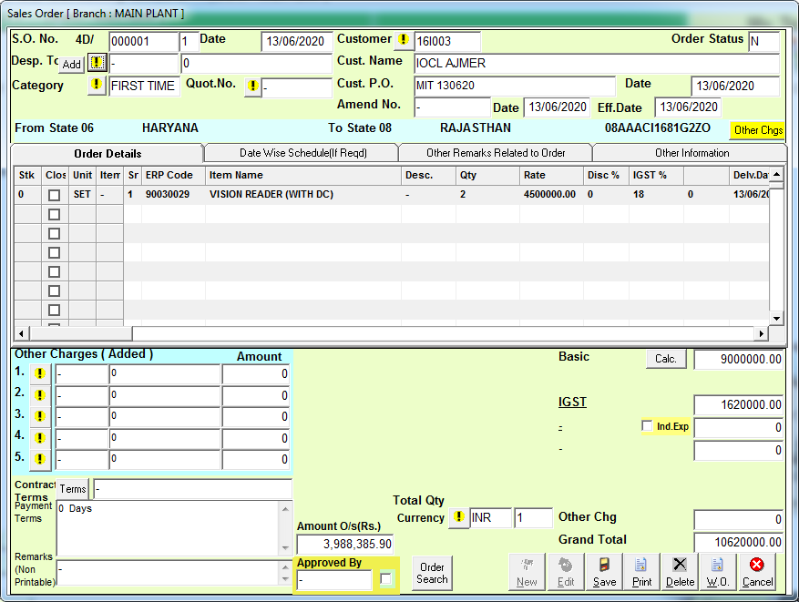

Slide 14
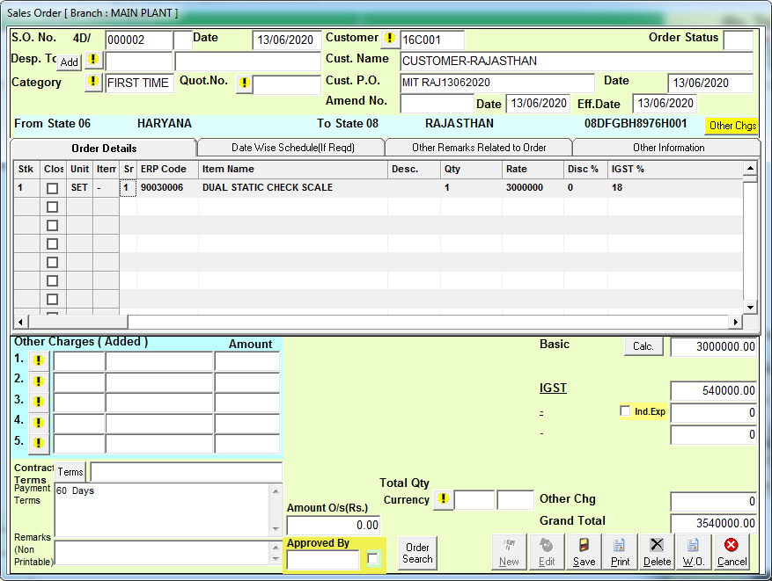

Slide 15
Just tell the Weekly Sales Plan to your Friend, the Finsys ERP

Slide 16
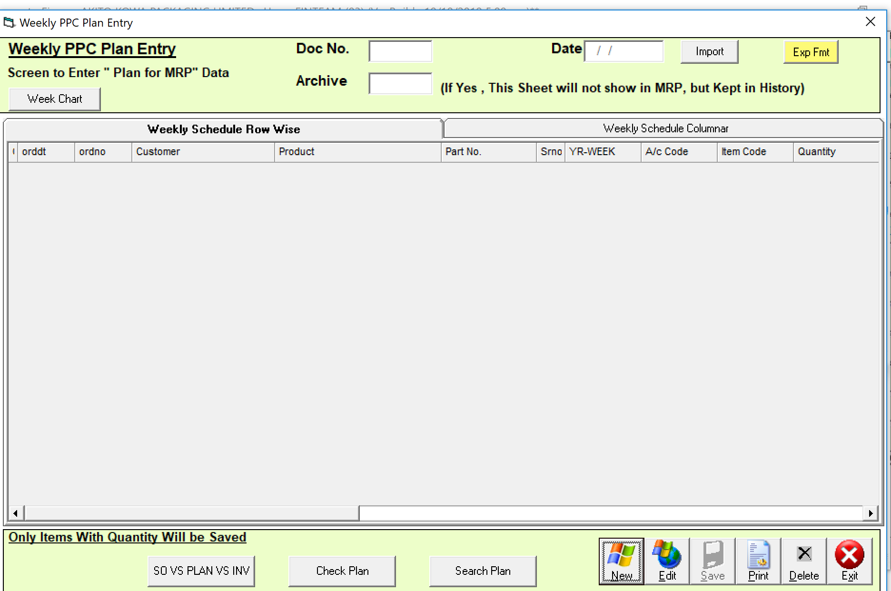

Slide 17
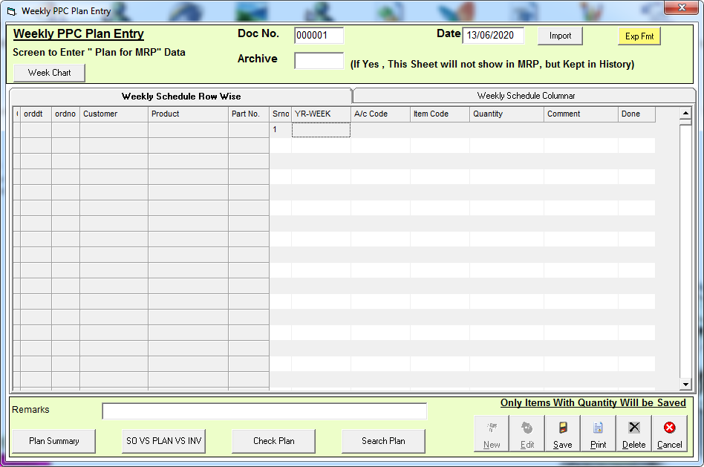
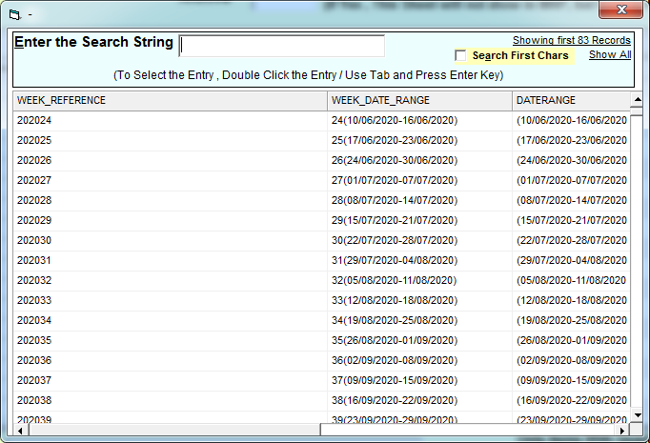
Select the Planning Week from available coming week list

Slide 18
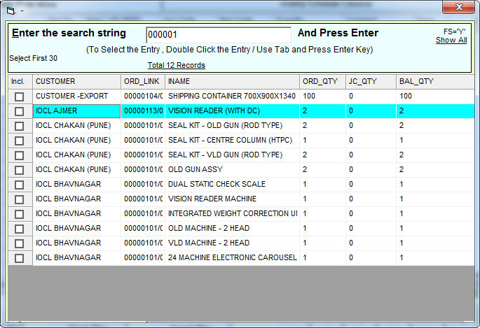
Select the Sale Order from available Pending SO List for You have to make Shipping Plan Week Wise

Slide 19
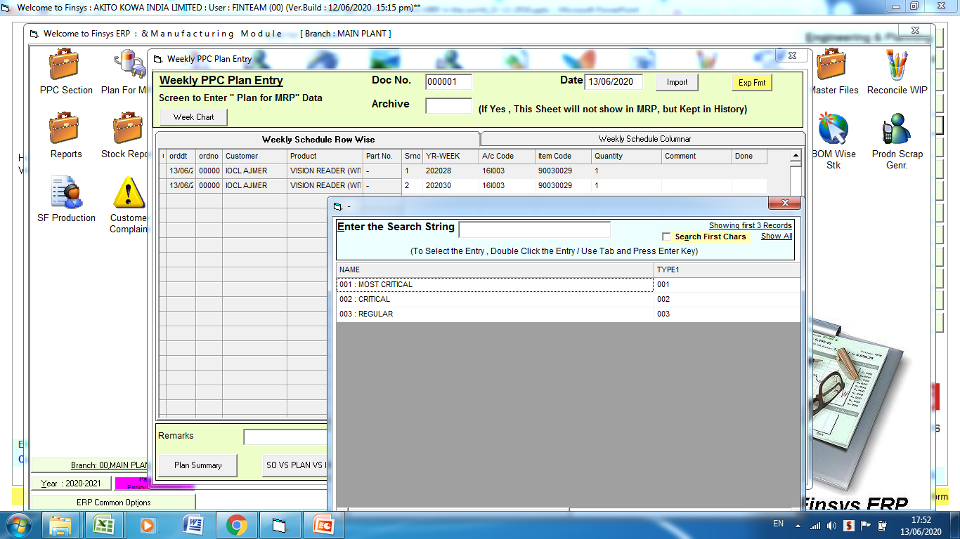
Select Comment Option to set the Priority Of Sale Product

Slide 20
Here We Picked the Orders scheduled to Ship in Week 26,27,28, 29, 30,31,32,33,34

Slide 21
MRP helps you become… Time Bound ..

Slide 22
Information Goes Digitally
To Purchase Dept
Digital info
Online
LIVE

Slide 23
Ready to Start MRP Run

Slide 24
Over to MRP MIT
Manf. Module-> MRP MIT

Slide 25
MRP … MIT MRP with Material in Transit

Slide 26
MRP MIT Screen→ Click on Start MRP Button

Slide 28
Auto SO_ Means System will pick those FG Item in Which we have mention Minimum Stock

Slide 29
Remember… we have to Reduce Stress due to “FG in hand”

Slide 30
Reduce Stress of excess Stock

Slide 31
First Success…. Automatic FG reduced

Slide 32
Report is ready ? Yes

Slide 33
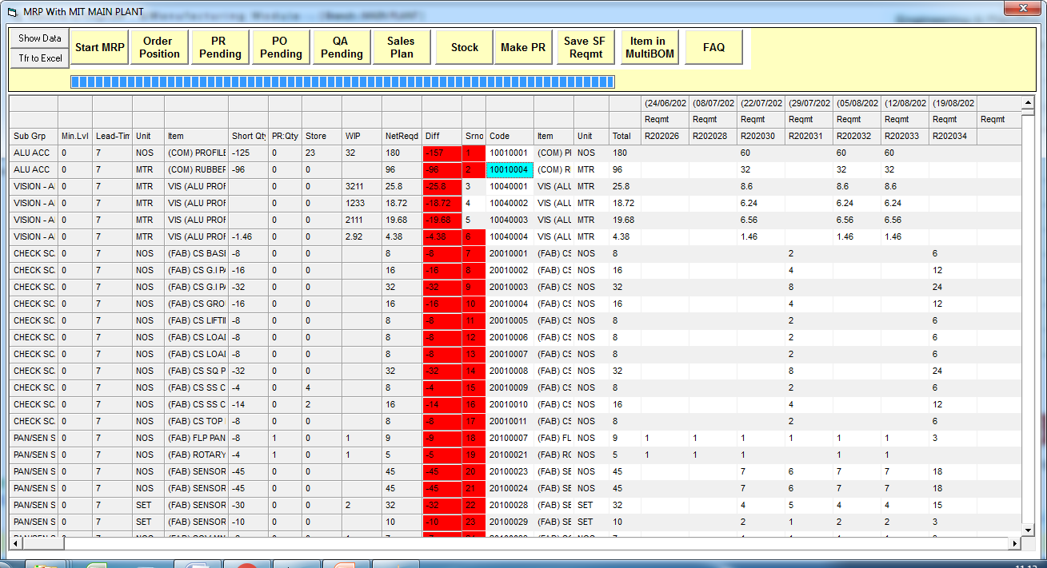
MRP MIT Screen Showing Week Wise Material Shortage Information as per Sale Plan sheet Schedule

Slide 34
MRP MIT Screen Showing Week Wise Material Requirement Information as per Sale Planning Sheet
Columns with Red Column showing these Material are short & Needs to Purchase
Column with Green Color showing these Material are sufficiently Available in Stock No Nees to Purchase

Slide 35
We have two option to Consider Total Available Stock
1st Option
Total Available Stock = Stock Available in Main Stock Only.
2nd Option
Total Available Stock => Main Store Stock + WIP Stock
We can go with Any of One option as compatible for our industry

Slide 36
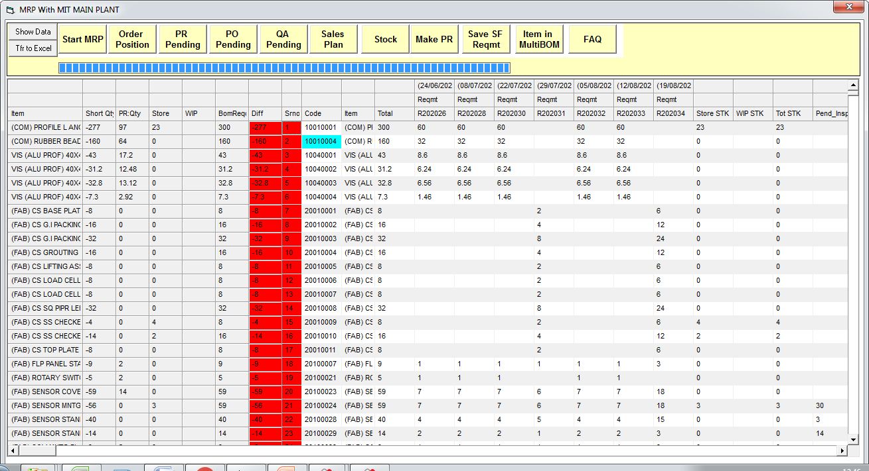
Here We are taking case 1st when we are considering Store Stock Only = Total Stock
Not considering WIP Stock for Material Requirement Shortage

Slide 37
Here We are taking case 2nd when we are considering Store Stock + WIP Stock === Total Stock
Total Stock35+1=36

Slide 38
Lets see “closely”, in detail

Slide 39
BOM Requirement… see Sr.No.116th ,118th,121th,122nd,123rd items, Not required , sufficient in Stores itself

Slide 40
Sr.No. 117,120,124 in Red… for Main Store Stock available, but not sufficient, hence Showing Shortage

Slide 41
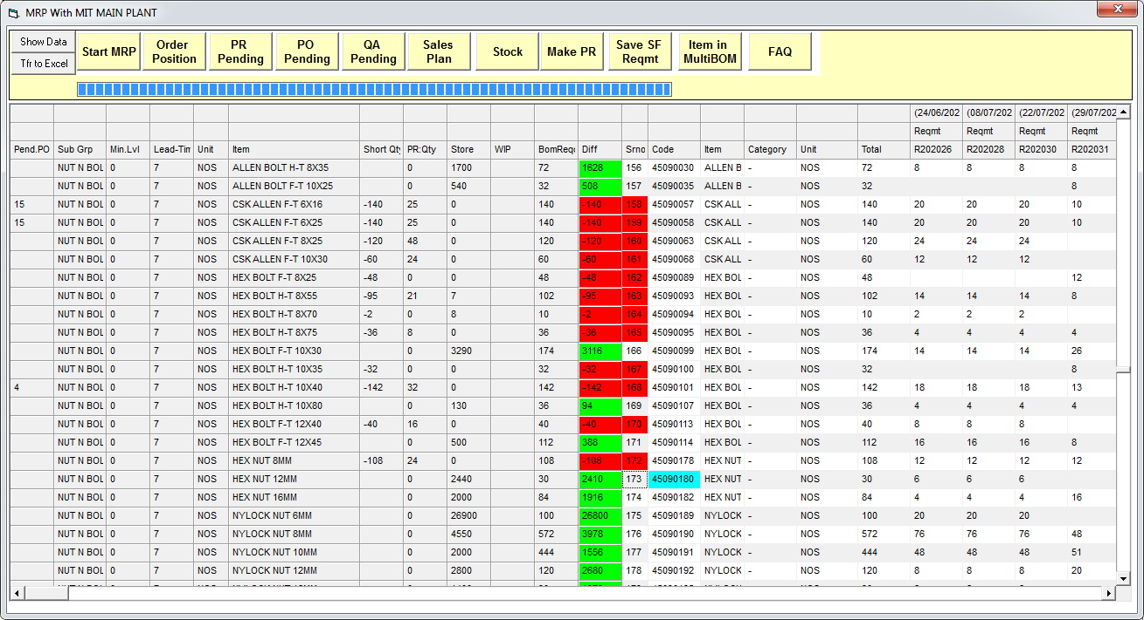
Showing Pending PO also

Slide 42
Our Promise to you……. Big Financial Savings will happen in Every company, which uses this

Slide 43
Cost Saving possible ? In your company ?

Slide 44
Production needs (Requirement of RM,PM) up to Next 12 weeks

Slide 45
Why this next 12 column’s issue calculation ?
Answer
What is required to issue ?
How much pressure is required to be given to Vendor ?
Truth about consumption ?

Slide 46
Benefits

Slide 47
Lead Time.. Logic
15 days lead time…
Divide by 7 = approx 2
So, next 2 weeks to be ordered now
Plus 1 week for safety

Slide 48
Another benefit
Security of your Money
And Peace of Mind

Slide 49
Colms for MIT also

Slide 50
Shortage… at week level White is cumulative Stock in hand & Red is Cumulative Shortage

Slide 51
Shortage… at week level White is cumulative Stock in hand & Red is Cumulative Shortage Week Wise … See closely

Slide 52
We Bow to our Patrons in the Industry, who taught all this to us… with their experiences

Slide 53
Excess Material that we have including Pending PO including coverage % for that week

Slide 54
Next… even more Savings…

Slide 55
Showing Pending PO which actually you don’t need .. Logically

Slide 56
CLOSE them…. Or Postpone them… tell the vendor

Slide 57
Now, ask ERP to make PR for all shortages itself

Slide 58
Press Make PR

Slide 59
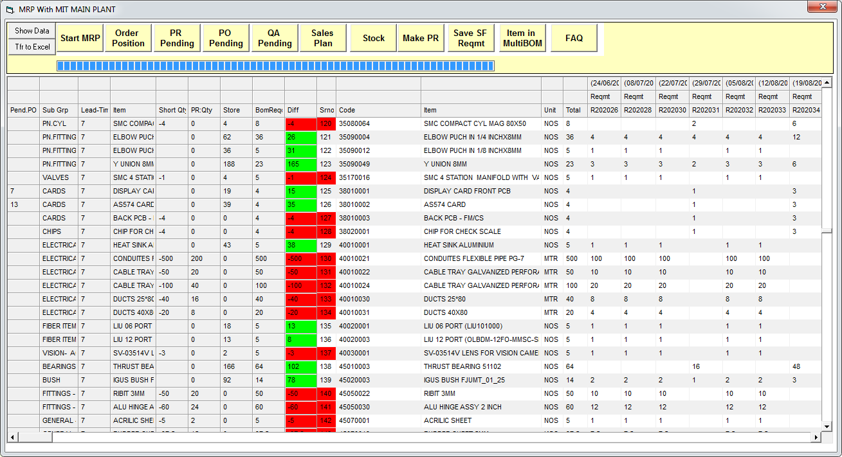
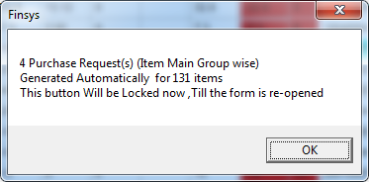

Slide 60
PR is made … congrats…. Could be 1000 items in 1 click Item Main Group Wise Means : System has generated Separate PRs for Each of Raw Materials Items – BOP Items – Hardware Items – Consumables Items Groups etc This Required Because In your company there will be different Officers who are looking for Type of Material Purchases .

Slide 61
When seeing through Edit Button All Four MRR are shown Here Where All PR are in unapproved

Slide 62
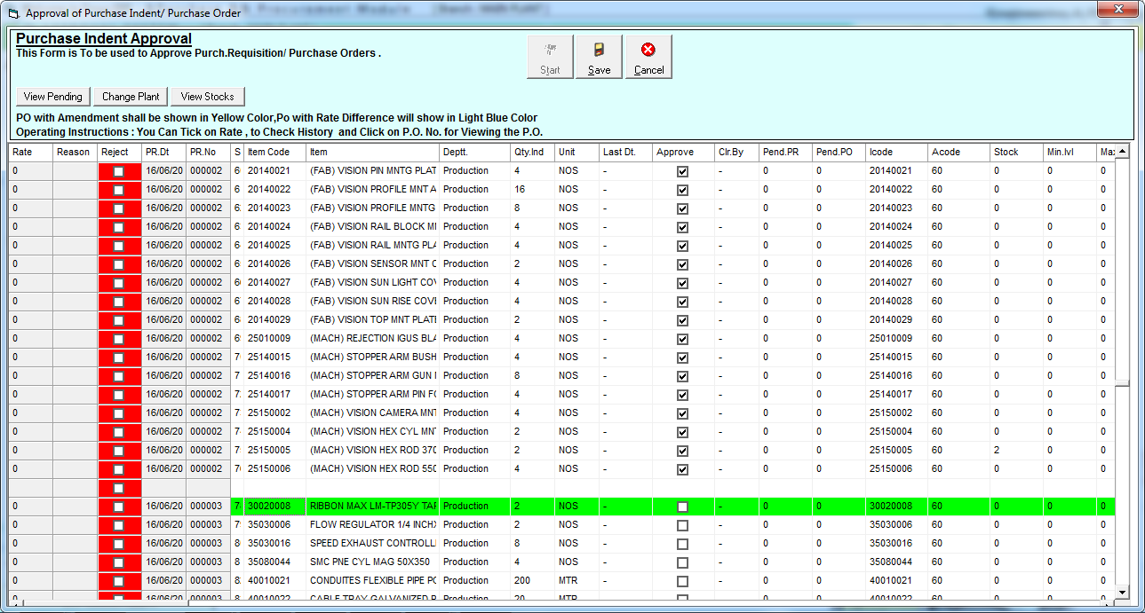
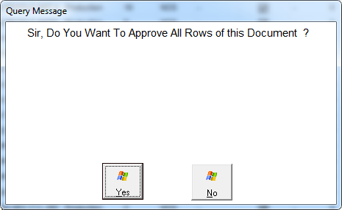
PR Approval Done Here with option to tick all line item with single click

Slide 63
All Pending PR are not shown while making PO, We just have to pick the requested item and make PO for related vendor

Slide 64
PO Creation Done Here

Slide 66
We have done here PO Approval

Slide 67
Other MRP Features .. Focus on your Gain

Slide 68
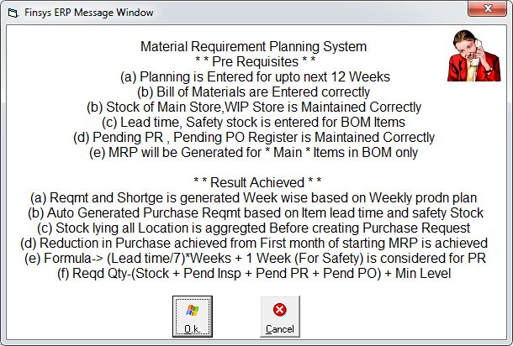

Slide 69
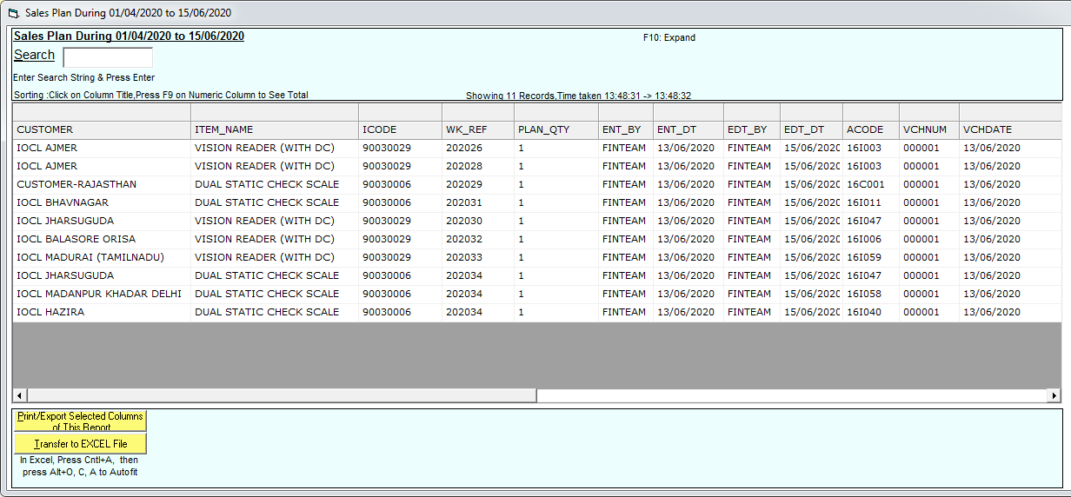
Sales Plan Button…. Including Archived Sales Plans

Slide 70
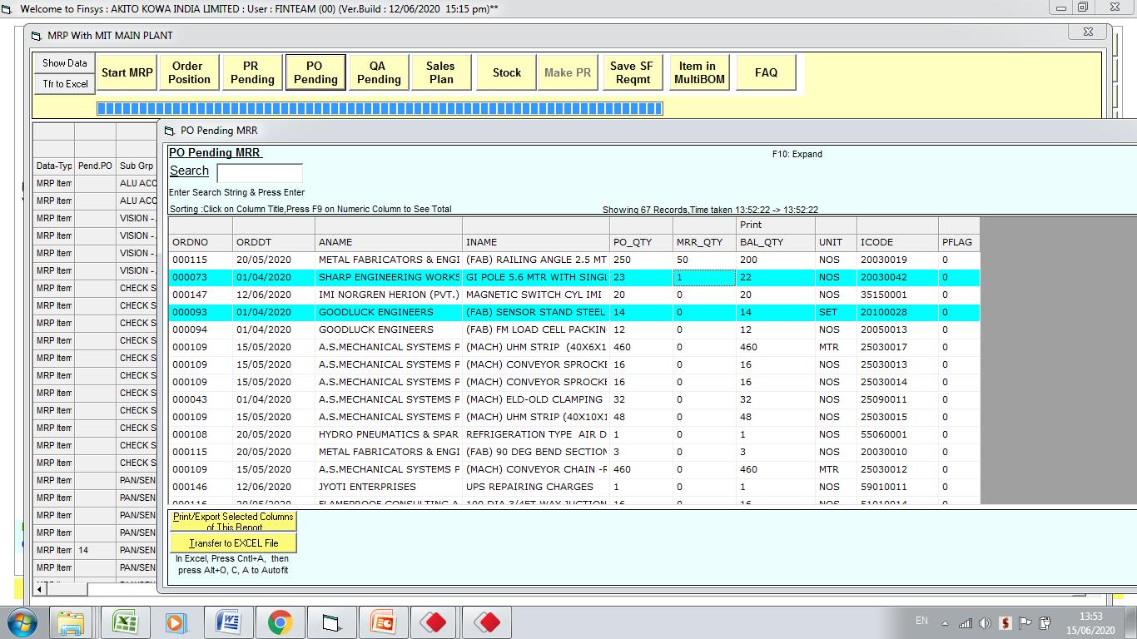
PO Pending…..

Slide 71
Pending PR – Pending Indents ?

Slide 72
Transfer to Excel

Slide 73
Option to export only Shortage Item or All Rows

Slide 74
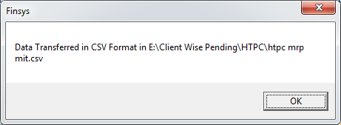

Slide 75
Finsys MRP Module is going to Make your Life Easy We PROMISE That

Slide 76
If you use these…..Benefits are as Good as you if discovered hidden GOLD in your company We Assure That

Slide 77
Try again ?
Next time, see what happens ?

Slide 79
Why Previ. PR will delete , Explain in detail

Slide 80
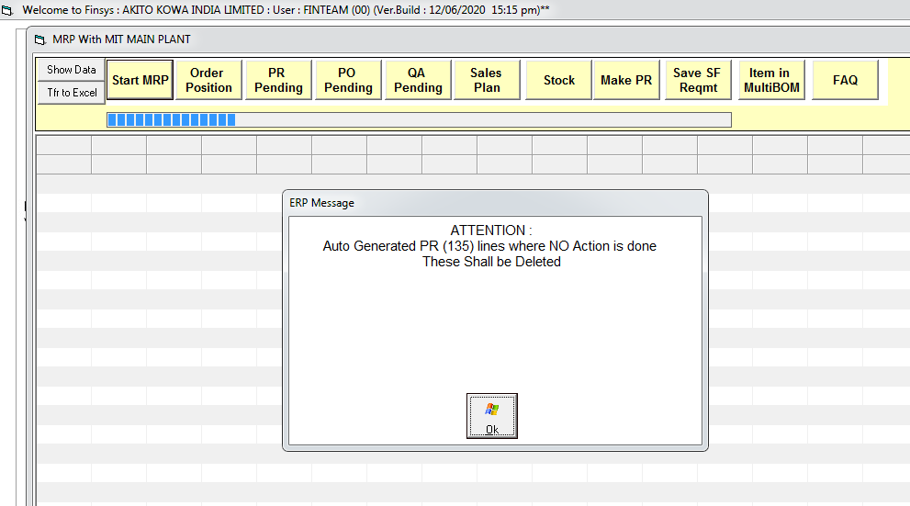

Slide 82
AI… Artificial Intelligence

Slide 84
Now we can start MRP MIT Process again with Fresh Material Shortage List find out and for data preparation for Purchase & Procurement

Slide 85
Finsys at your service

