Slide 1
Continuous Stock Taking & Physical Verification of Reels
In a Corrugated Box Factory / Flexible Packaging plant
Any Batch wise stock traceability Co.

Slide 2
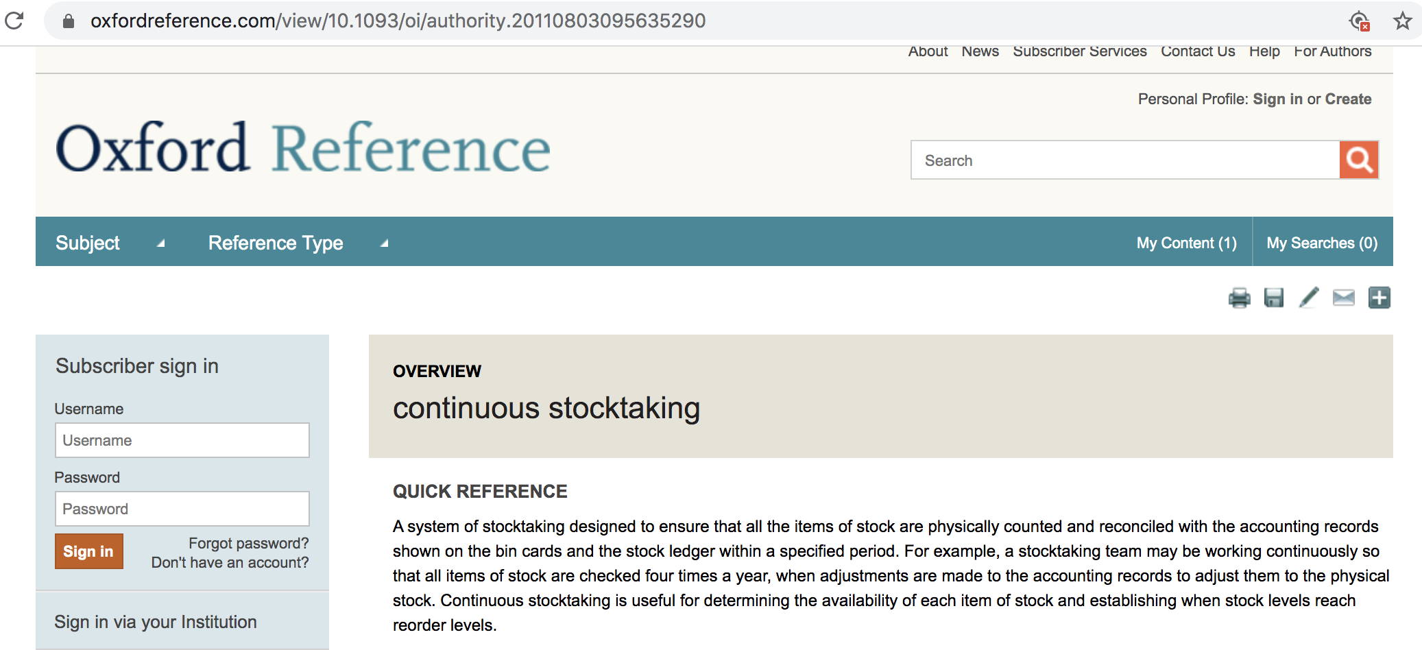

Slide 3
Oxford Dictionary :
A system of stocktaking designed to ensure that all the items of stock are physically counted and reconciled with the accounting records shown on the bin cards and the stock ledger within a specified period.
For example, a stocktaking team may be working continuously so that all items of stock are checked four times a year, when adjustments are made to the accounting records to adjust them to the physical stock.
Continuous stocktaking is useful for determining the availability of each item of stock and establishing when stock levels reach reorder levels.
https://www.oxfordreference.com/view/10.1093/oi/authority.20110803095635290

Slide 4
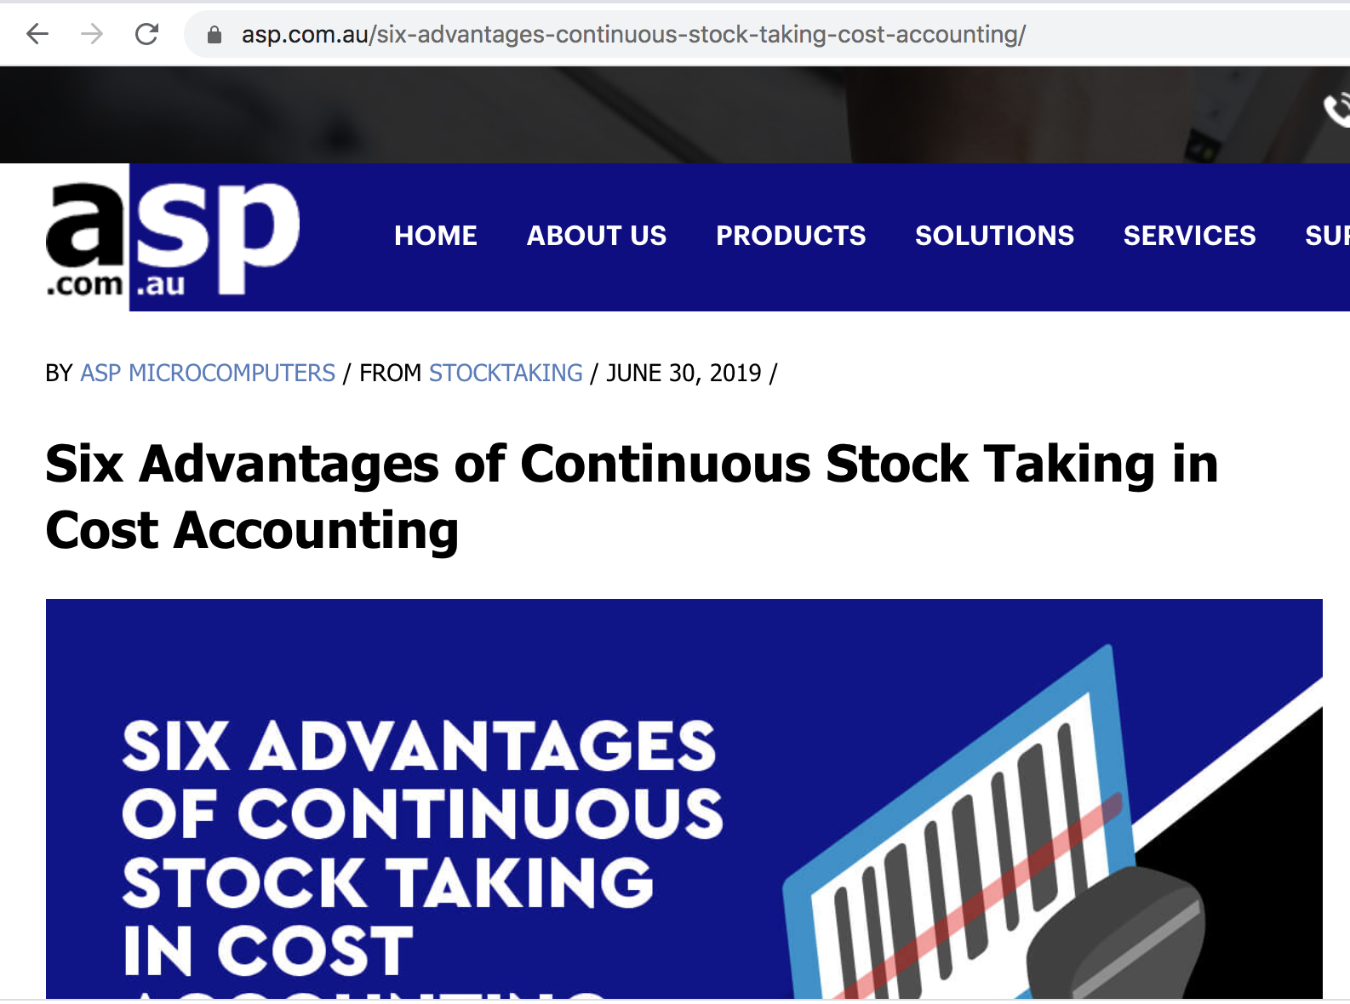

Slide 5
1. Accurate Accounts
Continuous stock taking places a lot of emphasis on the maintenance of accurate stock records.
As stated in the above definition, this stocktaking method involves checking physical stocks with the available records.
This means that the preparation of interim and even final accounts can be conducted using highly accurate figures.
This is especially important considering the fact that this stock-taking method can be used to specifically keep track of high value and fast moving stock items.
Lastly, any errors in the current stock records can be identified and resolved as early as possible.

Slide 6
2. Prevent Unnecessary Losses and Wastage
Continuous stock taking can help reduce wastage and loss involving stock items.
First and foremost, by tracking stock items on a continuous basis, entities can minimise cases of ending up with obsolete stock items, and the associated losses.
Furthermore, tracking stock items on a regular basis works to deter employees from any cases of dishonest conduct when it comes to handling stock items.
Finally, by maintaining the right level of stocks, businesses can eliminate the wastage associated with carrying of excess levels of stock.

Slide 7
3. Improved Stock Management
By conducting a regular stock check, businesses are able to implement and maintain better stock management practices.
A continuous stock take goes a long way towards helping businesses get a clear idea of the flow of stock items.
The lessons learned here can be applied in the creation of accurate forecasts and budgets that reflect the actual stock movement reality.
This can help businesses avoid cases of running out of important stock items or having too much capital tied up in excess stock.

Slide 8
4. In-house Experts Can Be Used
This stocktaking method distributes the tedious and often time-consuming job of verifying stock items across the year.
This means that businesses can assign the task to an internal staffer instead of calling on a team of external experts every now and then.
Smaller businesses can even assign work to one of the existing employees.
The assigned staffer can simply count stock items and enter the information in forms designed for this specific purpose, while the work of comparing actual figures to the existing records is left to the store’s clerk.

Slide 9
5. No Need to Shut Down Operations
One of the main advantages of continuous stock taking is the fact that it can be done without closing the business down.
Entities do not have to shut down their operations and suffer the associated disadvantages to confirm stock numbers.
Stock figures are updated on a regular basis, as receipts and issuances continue.

Slide 10
6. Eliminate Delays in Production And/or Delivery
After businesses identify the trends in stock movement, they are able to maintain sufficient stock levels to meet any fluctuations experienced throughout the year.
This helps minimise the likelihood of production disruptions caused by running out of stock unexpectedly.
Most importantly, it ensures that businesses can meet customer orders on time, every time.
As you can see from the above continuous stock taking doesn’t just help businesses maintain accurate stock records, it also helps improve the overall profitability of the entity.

Slide 11
Physical Verification+ location Steps for Corrugated box industry, all Industries, anybody who wants to consider barcoding in his factory

Slide 12
#1 -- Why is Physical Verification Important ?
Reliability for
Correct Profit and Loss A/c.

Slide 13
#2 --- Why is Physical Verification Important ?
Bank stock Report
Correct Drawing Power

Slide 14
#3 : Why is Physical Verification Important ?
MRP : Material Requirement Planning
Correct Closing Qnty is known

Slide 15
Does physical verification mean, redo from start ?
No
That is not so

Slide 16
Traditional Year end inventory system
Redo from start
recount
re upload
ignore the Past
Restart reel system

Slide 17
#1 : Reasons for diff in ERP Records vs Actual
Wrong opening reel number
Missed some reels in opening
Missed bit reels in opening
Wrong kg in opening
Wrong supplier reel number in opening
Wrong Item code selected

Slide 18
# 2 : Second set of reasons ?
Receipt entries done,
But issue entries not done
People Take time to absorb Systems

Slide 19
Risks involved ? # 3
Reel Issue entries done,
but receive back bit reel not done
(REEL RETURN MISSING / PARTIAL)

Slide 20
Risks involved # 4
BARCODE not put back on the bit reel
All are mix up
Nobody knows the source / origin / kg

Slide 21
What happens if I dont get accurate results in YEARLY inventory system ?
redo from start
recount
re upload
ignore the Past
Restart reel system

Slide 22
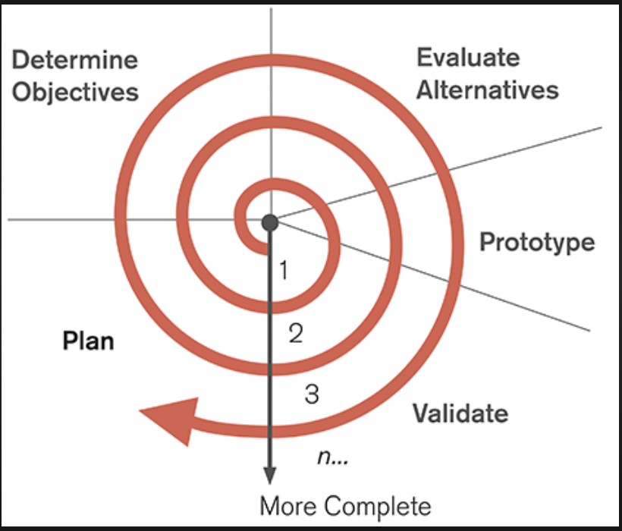
Continous inventory is a part of SPIRAL Implementation

Slide 23
Each cycle
Take a process
Do best possible planning
Execute
Monitor results
Take learning
Do again , as a spiral
Understanding, knowing that it is a spiral

Slide 24
Continuous inventory and Daily physical verification method

Slide 25
This is a lifetime activity
Do Reel verification, daily, or weekly
One BF Grade a day / one GSM Grade a day
There will always be some differences
Small
Big
No worries
Do it

Slide 26
and
Daily find the errors, correct in ERP
diagnose root cause, plug it.
discuss in the committee
Solve problems
Corrective action
Preventive Action

Slide 27
How is this done in Finsys ERP ?

Slide 29
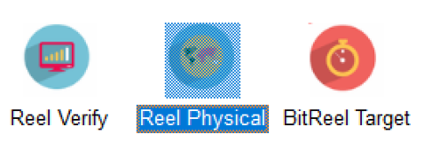

Slide 30
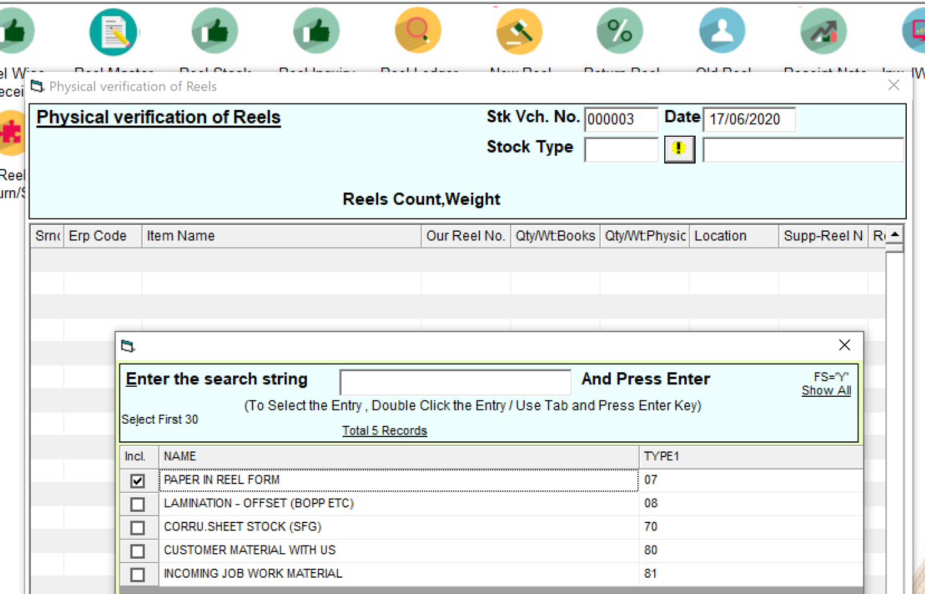

Slide 31
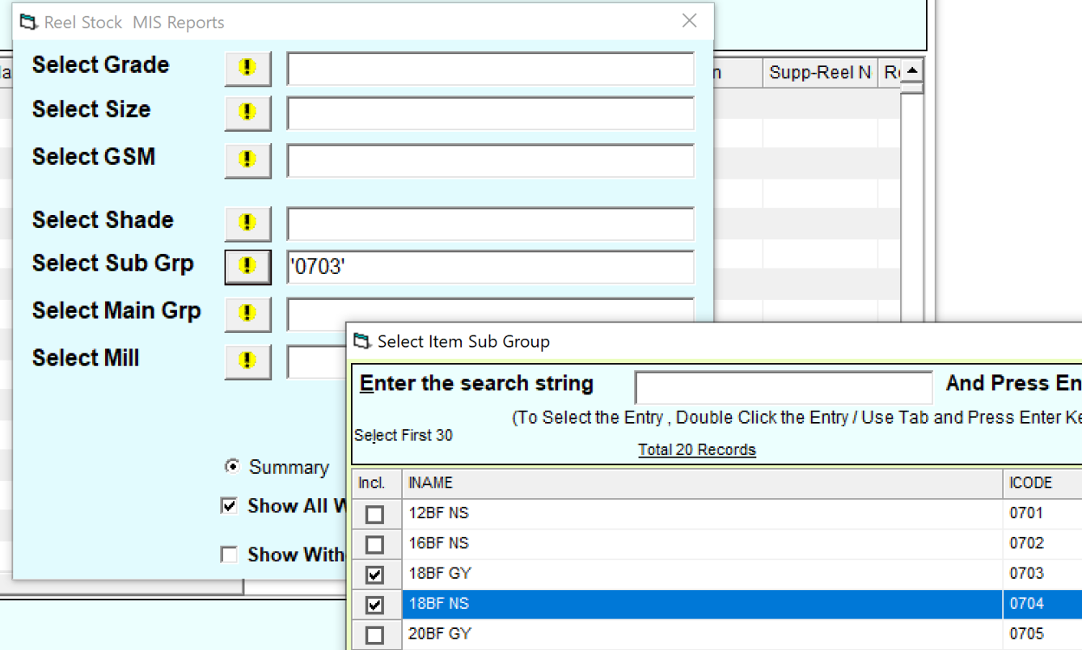
Select a Grade / Subgroup

Slide 32
Select a location ….you can do one BAY a day

Slide 33
Who will do this ?
Either existing stores people
Or a Dedicated two persons team, doing this only (Recommended)

Slide 34
Finsys has all 3 componentss

Slide 35
Shows…. As per ERP. This reel number..this location. this much kg

Slide 36
Pop-up for Location : Where did you find this reel ?

Slide 37
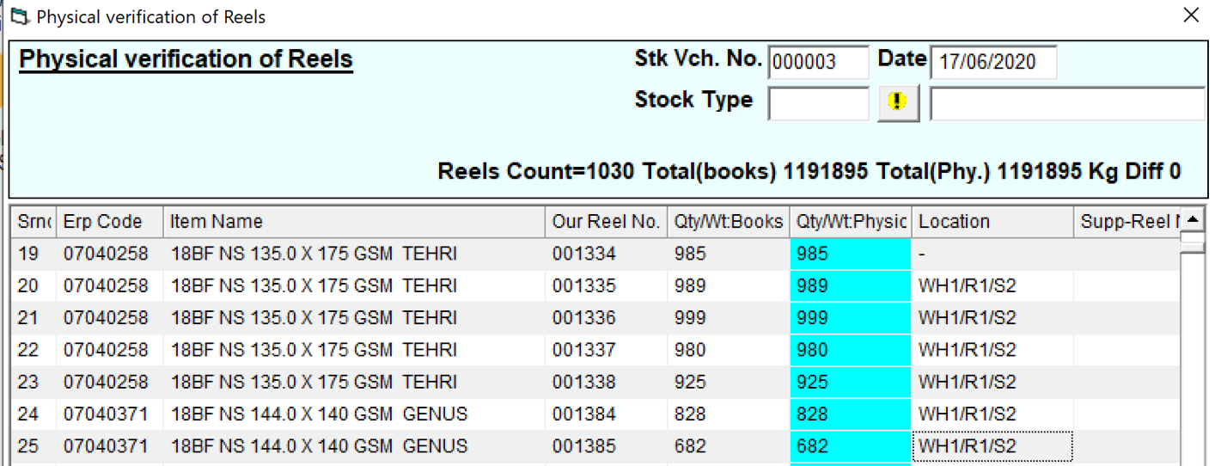
Told the computer….. Where is this reel now ?

Slide 38
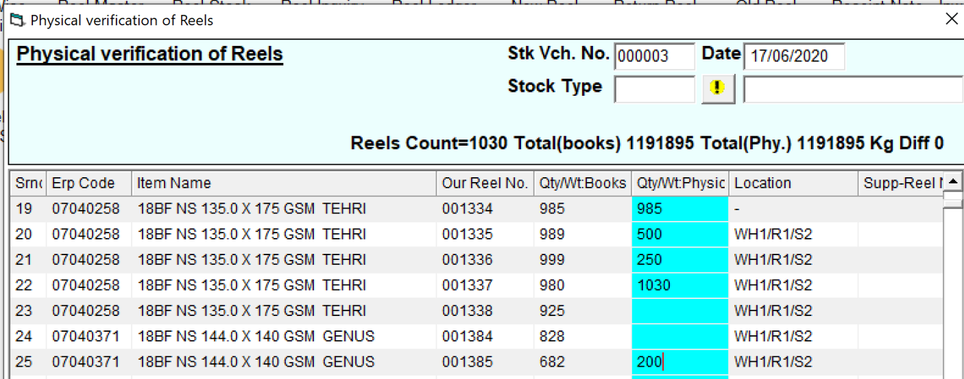
See closely…. Some reels are ok, some are bit reels, and some are higher

Slide 39
See closely…. Some reels are missing

Slide 41
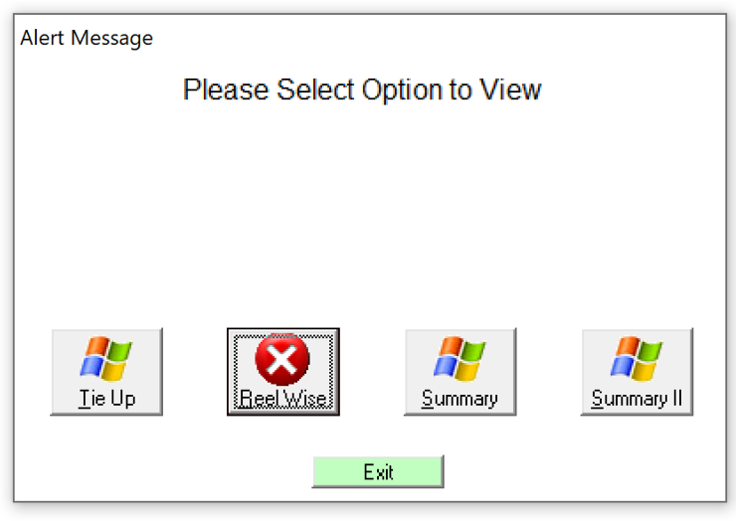
Tie-up Report – Reel Wise

Slide 42
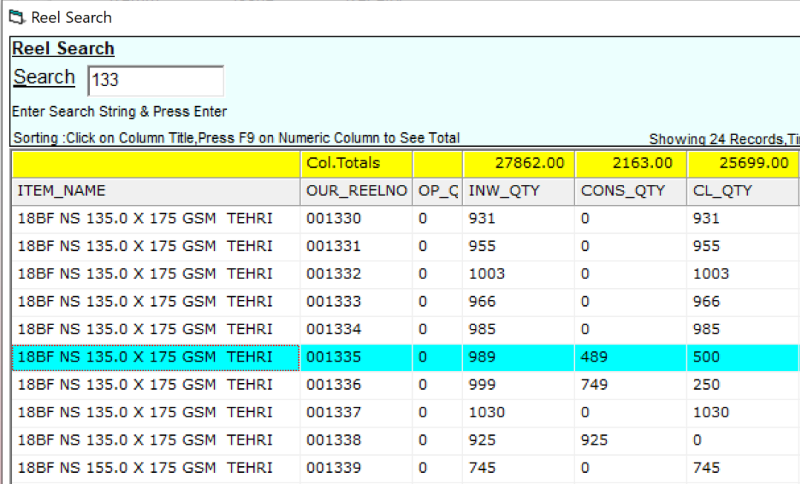
Automatically, the Reel 1335, is now 500kg left

Slide 43
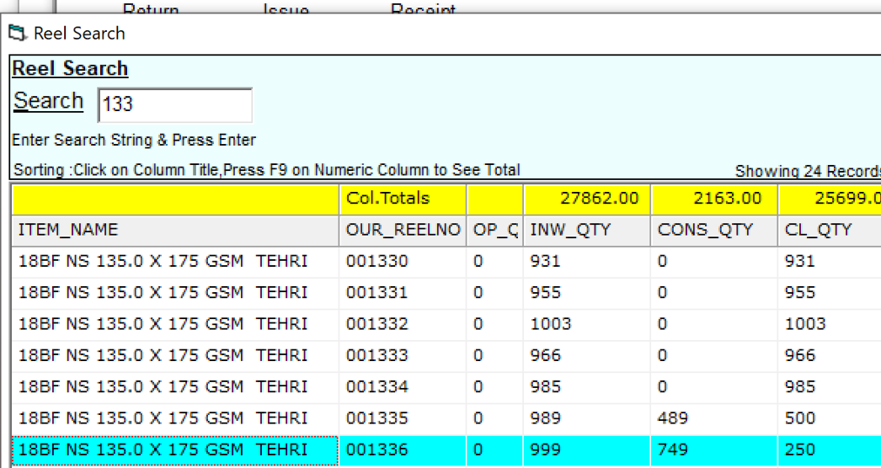
Automatically, the Reel 1336, is now 250kg left

Slide 44
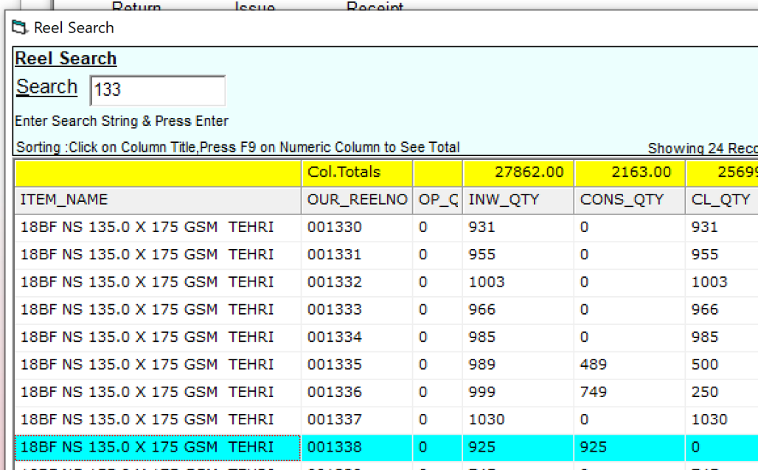
And 1338 ….. Closing is zero, since it was missing

Slide 45
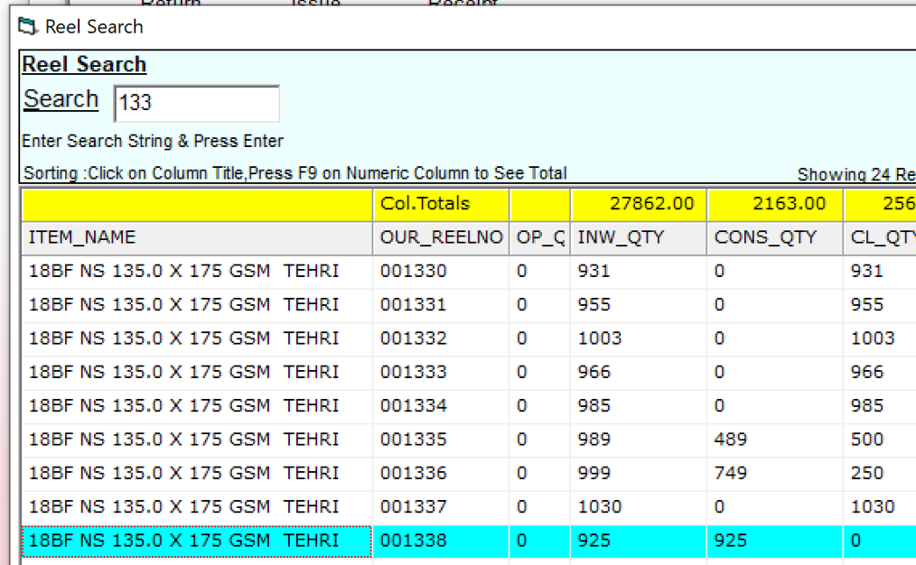
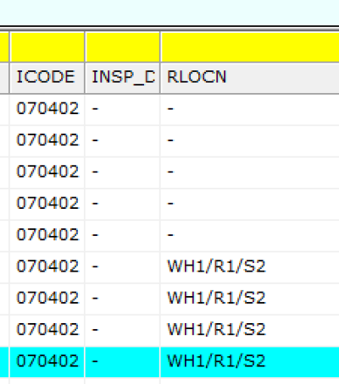
Showing the location also ……

Slide 46
Reel wise movement is also visible

Slide 47
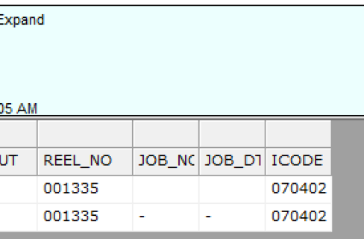
Note… since we are not issuing with job card linking, so right now, job number is missing for this physical verification based reduction of stock

Slide 48
See closely…. One reel, kg had increased

Slide 49
So, here it is, automatic

Slide 51
What if ? Daily difference continues ?
Daily error ?
Means lack of discipline

Slide 52
What if ? Excess ?
Discuss in meeting
Find root cause
Take action to add back

Slide 53
What if ? Item code difference ?
Discuss in meeting
Find root cause
Take action to edit/transfer/inventory JV

Slide 54
What if ? Bit reels not counted earlier ?
Add them now
Go to bottom of the grid
And add them

