Slide 1
GST compliances Simplified

Slide 2
Go to 'Finance Module'
29/07/2017

Slide 3
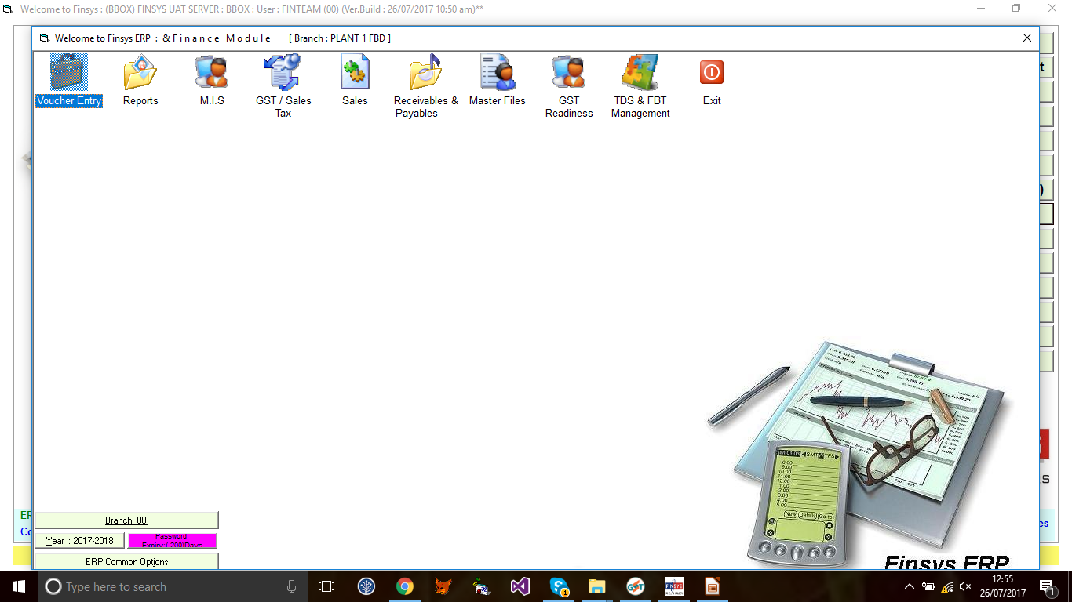
Then Go to 'Voucher Entry '

Slide 4
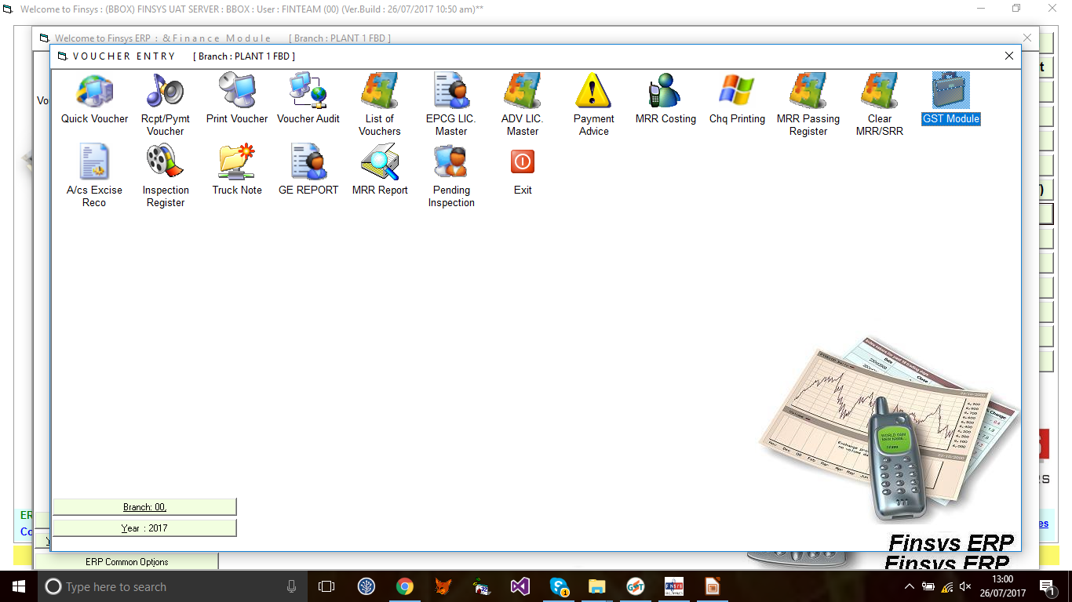
After That go to 'GST Module'

Slide 5
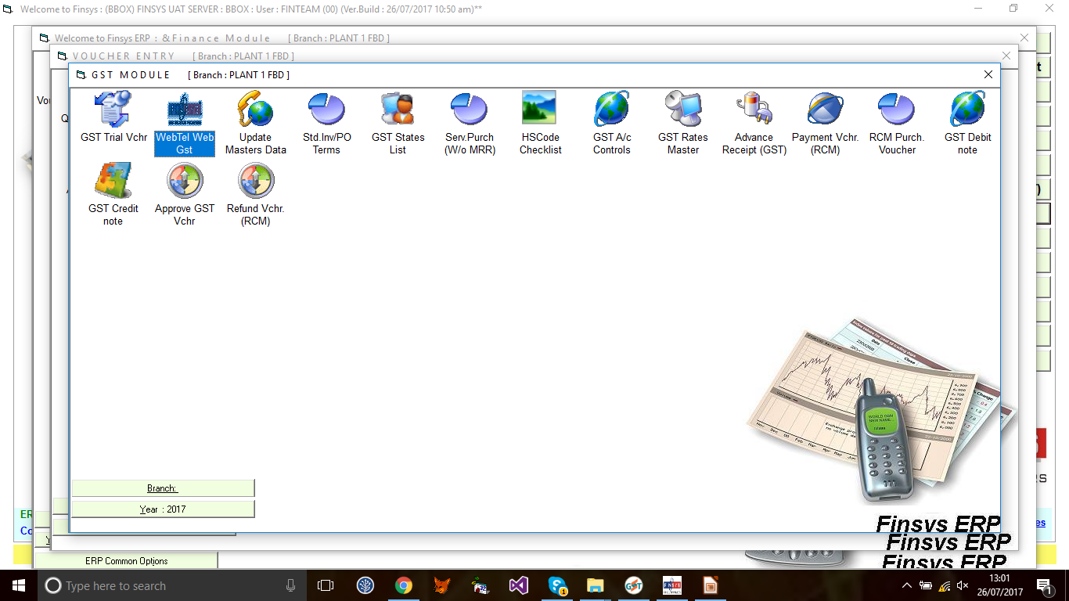
Click Webtel Web GST

Slide 6
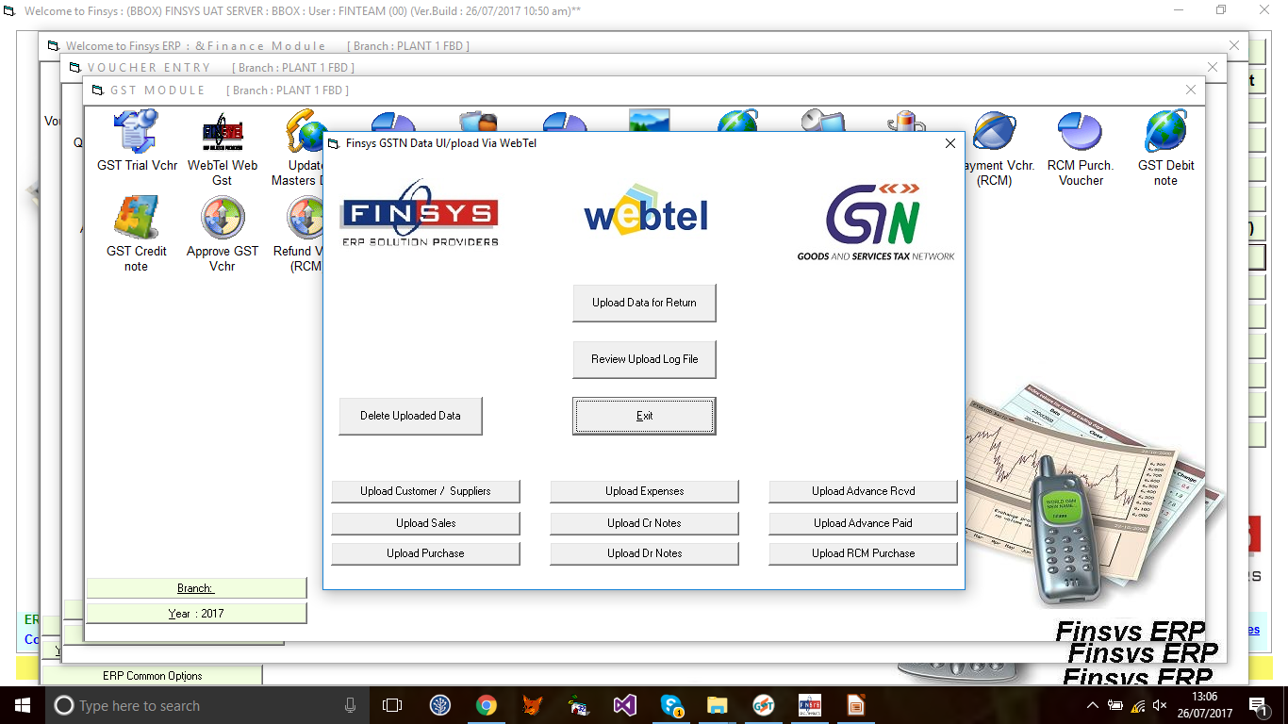
Select “Upload Data for Return”

Slide 7
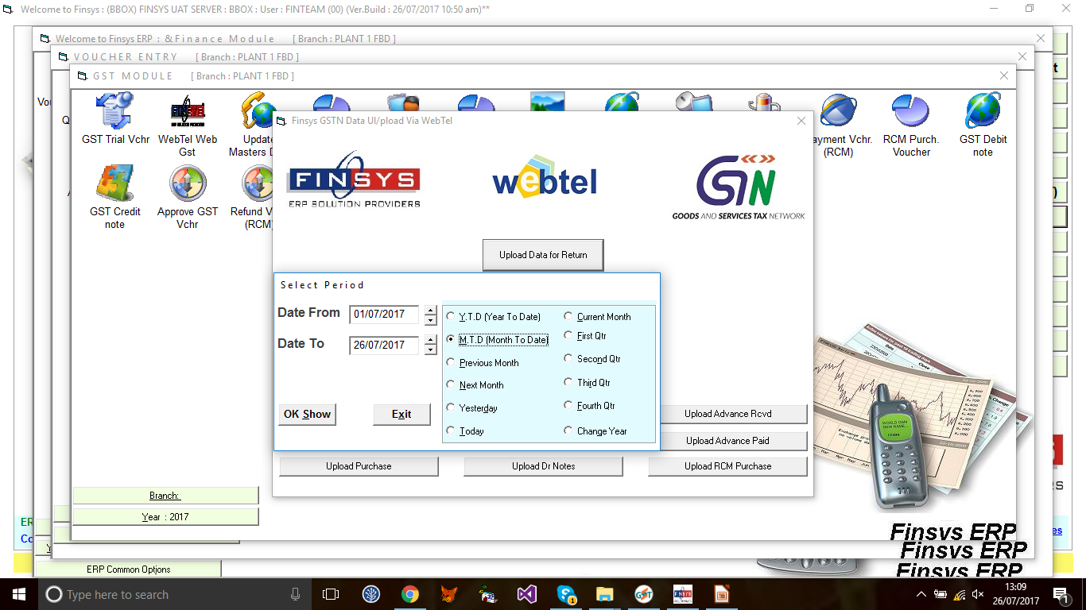
Select the period for which data to be uploaded

Slide 8
Validations
Party Master data must be correct with valid PAN and GSTN details.
State Code must be valid as per government List of States.
.
29/07/2017

Slide 9
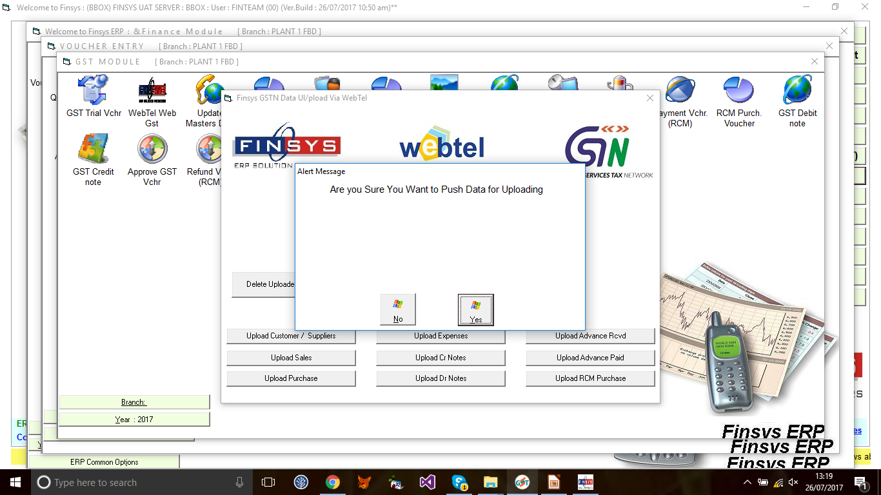
Push the Data into Web-eGST

Slide 10
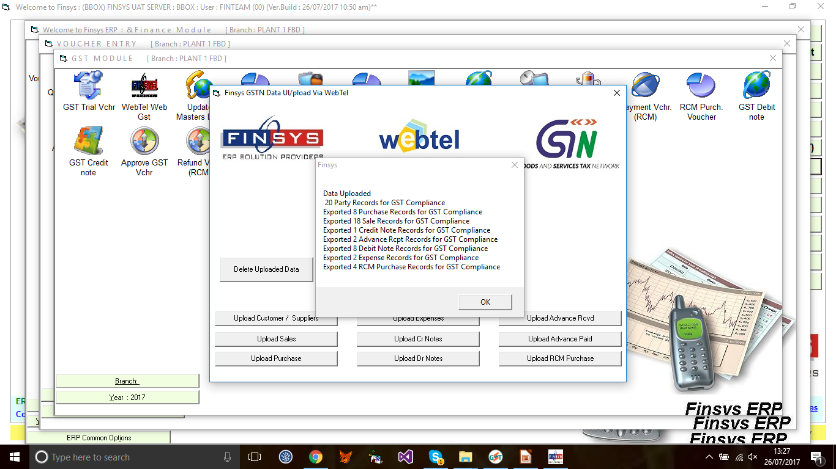
Data Uploaded

Slide 11
Screenshot of Webtel’s front end tool

Slide 12
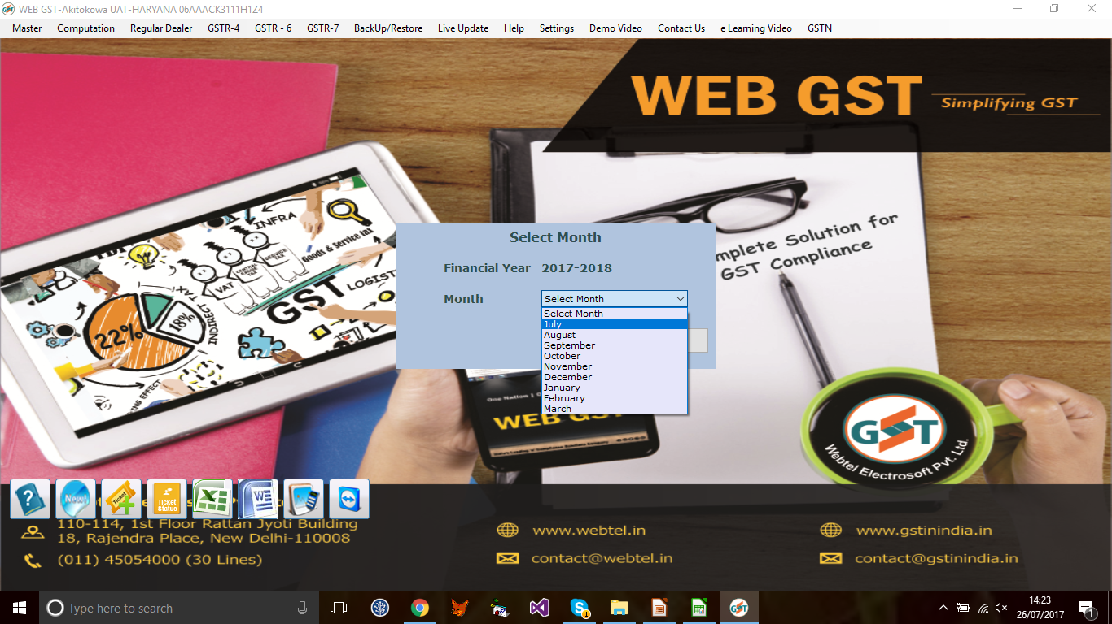
Select the month , then computation
Notes:
12

Slide 13
Computation sheet
A summarized sheet of your monthly outward and inward supplies mapped as per GST Returns requirements.

Slide 14
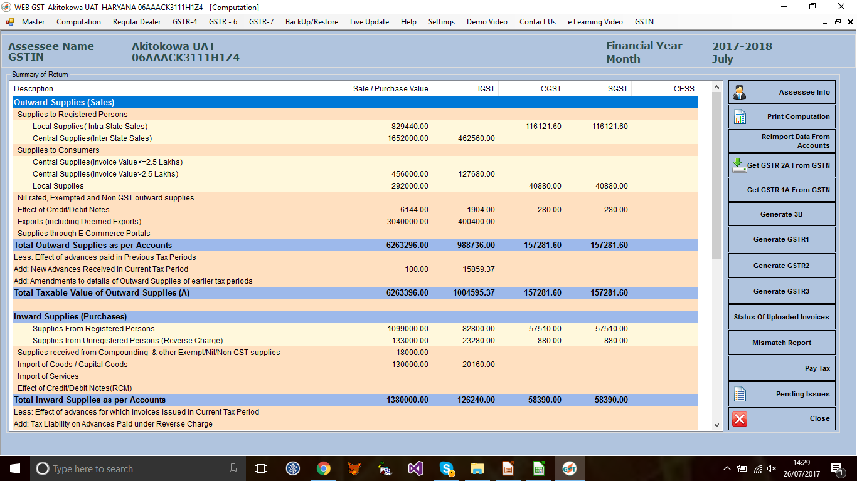
GST Computation sheet (Supplies outward side)
Notes:
14

Slide 15
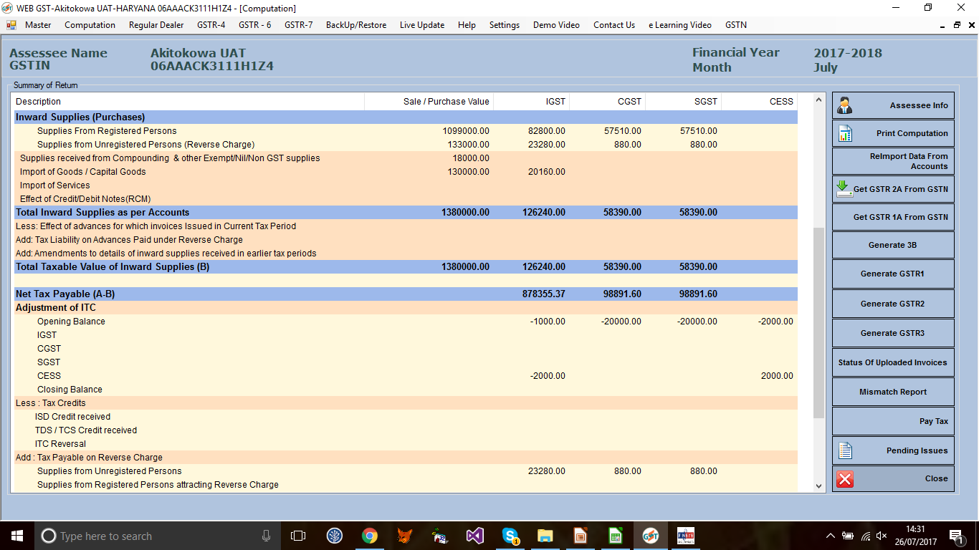
GST Computation sheet (Inward Supplies side)
Notes:
15

Slide 16
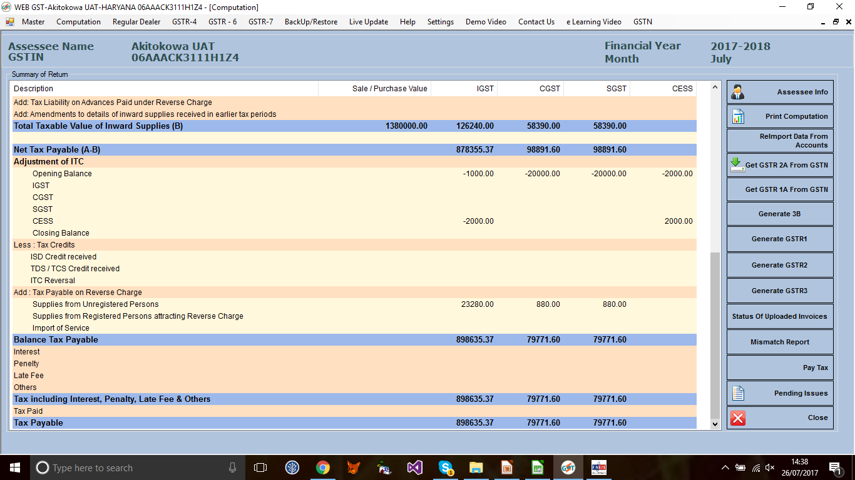
GST Computation sheet (Tax adjustments)
Notes:
16

Slide 17
Let’s analyse NOW.....
How the Integration will help and ensure that the data is mapped automatically and correctly.

Slide 18
To simulate, we have deliberately kept the data size to minimal.

Slide 19
Let’s take example of Inter State Registered Sale and the related document i.e. invoice in both the softwares and its impact on GST Returns.

Slide 20
Supplies Intra/Within State
Sales Register -FINSYS
Sales Intra State: Registered Customers ( 170300+244420)=Rs. 414720.00
: Unregistered Customers= Rs. 146000.00
Total Intra State Supplies :Rs. 560720.00

Slide 21
WEBTEL GST Computation sheet (Sales side- Intra State)
Local Supplies Registered dealers Unregistered dealer
Notes:
21

Slide 22
Local Supplies to registered dealers
(Drill down: Party wise details)
Notes:
22

Slide 23
WEB GST
Supplies - Within State Registered Parties Invoice wise
Party Name
SGST Payable
Taxable Value of
supplies
Invoice Details
Total Value of Supplies
CGST payable
Party GSTN

Slide 24
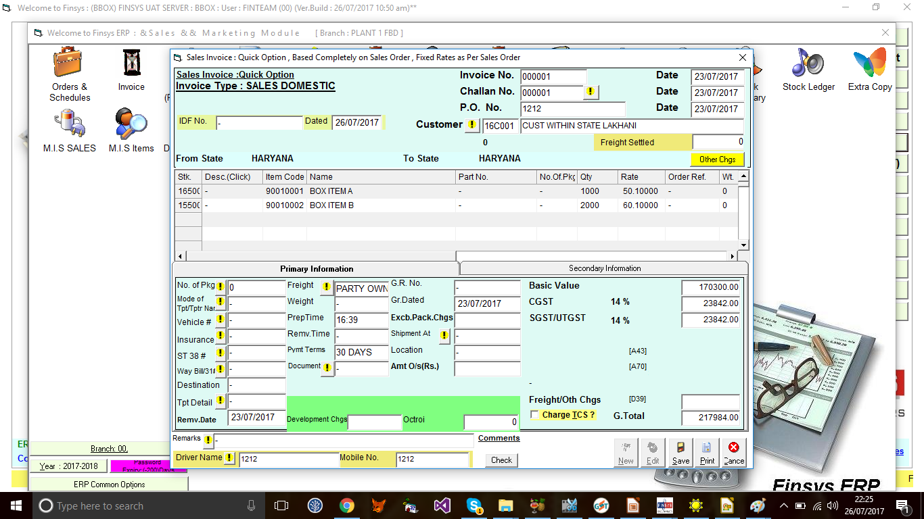
Invoice Details entered in Finsys

Slide 25
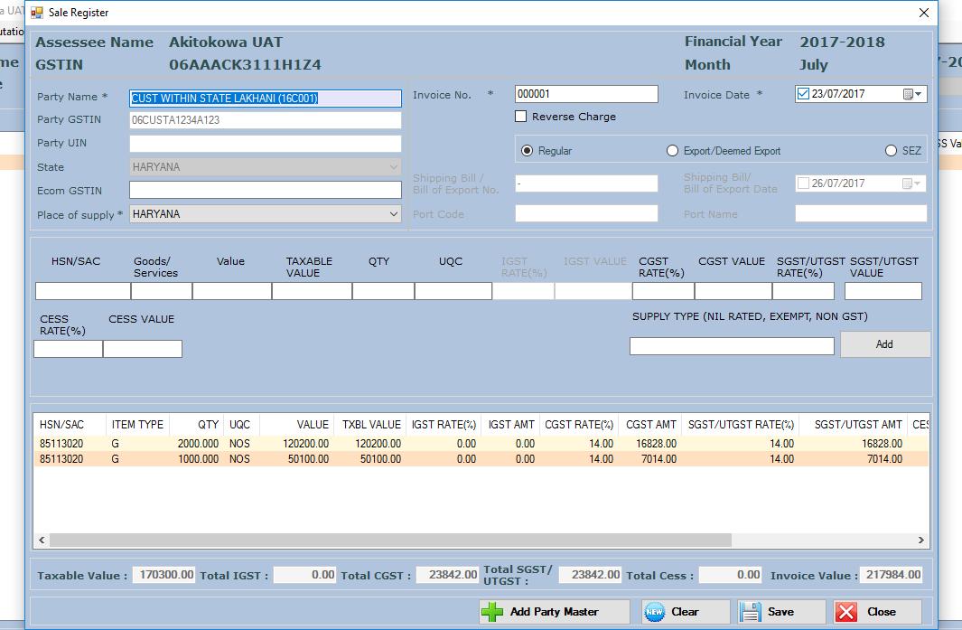
Invoice detail captured in WEB GST

Slide 26
Total Outward Supplies Reconciliation of
Finsys Sales Register
and
Web GST Computation sheet

Slide 27
Total Sales as per Sales Register FINSYS
2532000+1282000+560720= Rs. 4374720

Slide 28
Total supplies outward as per Web GST
414720+825000+456000+146000+2809000
=Rs. 4374720

Slide 29
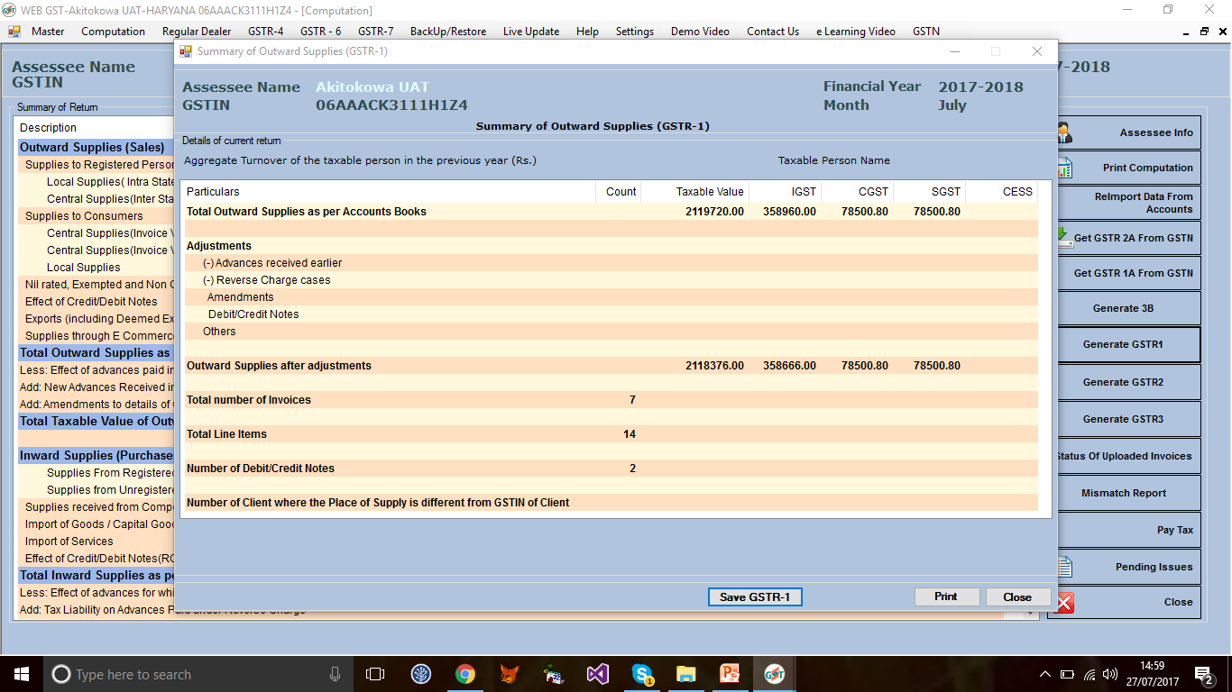
Click GSTR-1

Slide 30
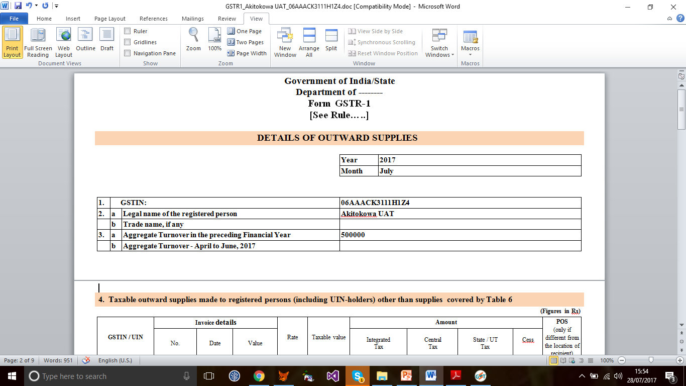
GSTR-1
Print

Slide 32
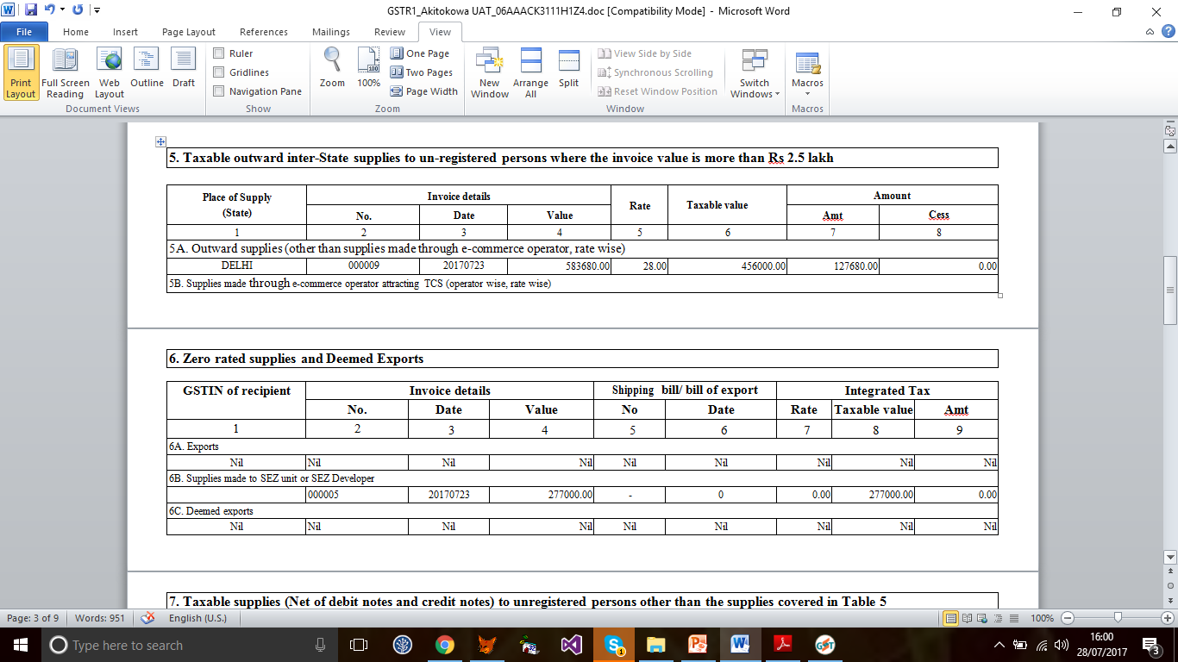

Slide 33
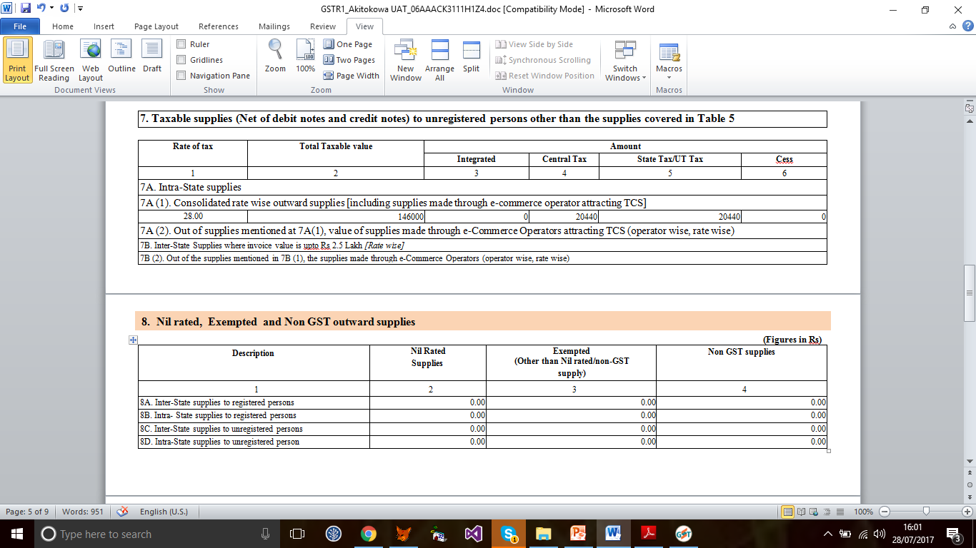

Slide 35
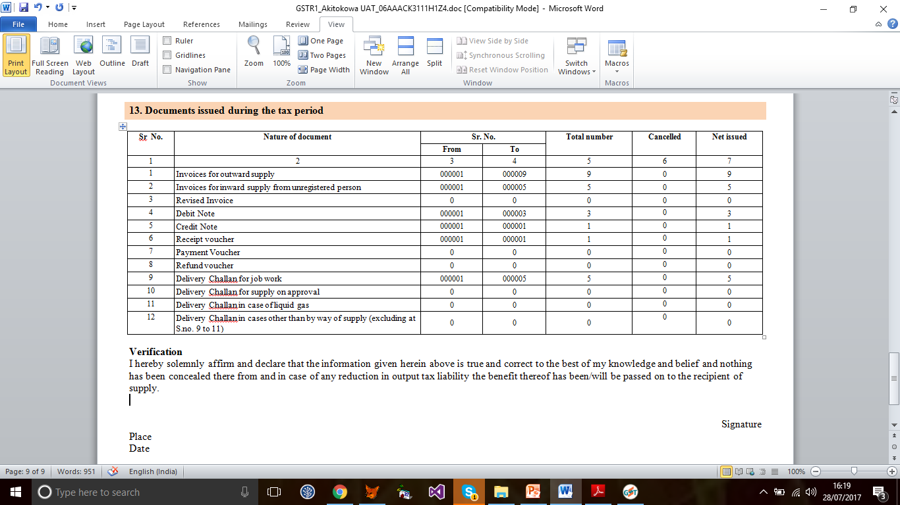

Slide 36
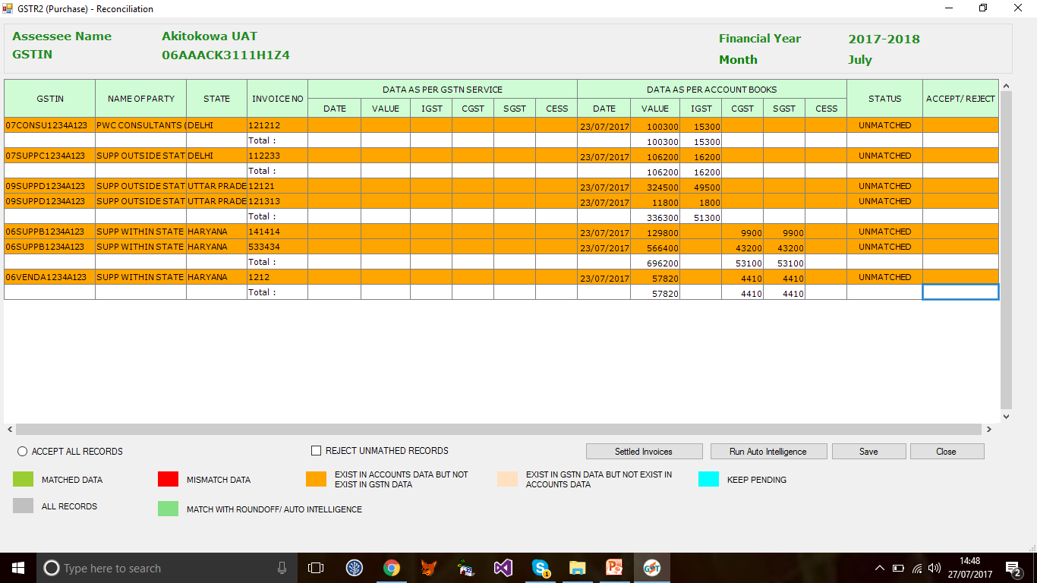
GSTR-2- Purchase Reconciliation
Showing mismatches

Slide 37
Finsys and Webtel
Your unmatched tool for GST compliances & growth
For queries please contact(Webtel) Mr. Saurabh Kumar 0971120734
Mr. Jayant 09999851101
29/07/2017

