Slide 1
Semi Automatic Corrugation Production

Slide 3
Semi Auto Corrugation
First FG
Then SO
Sales order approval
Process plan
Approve process plan
Item stage mapping
Make f1 for Job card / Job planning
Approve Jobcard
Machine loading planning ( Work order planning)
Now issue the material from stores

Slide 4
Main Differences ? / special things to remember (as compared to Automatic)
Machine Loading (Work order planning)
Some reports are different
Process plan is different
Job Card is different
Stages are more
Stage machine selection is important

Slide 6
CUSTOMER
SEE ITS GST data etc

Slide 7
IGST Automatic
Since Maharashtra to Haryana

Slide 8
Sales order Entry
Price History , automatic

Slide 9
Outstanding automatic
From accounts module

Slide 10
FG Stock Automatic
From the
FG stock ledger
Also called RG-1 in old excise rules

Slide 11
IGST Automatic
Since Delhi to Haryana

Slide 12
Sales order Acknowledgement / acceptance / Record
Print and file / Approve it

Slide 13
Process Plan
Initial version
Semi blank
From copy / paste

Slide 14
Select , which Die for Die Cutting Machine ?
Link in the process plan

Slide 15
Fill up manually
OD
ID
Ups = 48
Colors = 8
Main sheet
Alternate paper option is there,

Slide 16
Costing of the Mono Carton ( Paper )

Slide 17
Link the Inks
Which inks
Link the Item code
Used in
Purchase/stores module

Slide 18
Others
One time fillup
Varnish
Lamination
Corrugation
If any

Slide 19
Link the Kraft paper in flute and liner
Comes from popup
Also give the Flute

Slide 20
Popup for the “Flute”
Shows the takeup factor and height too

Slide 21
Fill in Adhesives
Also the
Stitching / pasting / stapling
Also
Final Packing

Slide 22
Info
Given for
All steps
Of the Production
To the team

Slide 23
Concept of Amendment number

Slide 24
Item Stage linking
Stages
Machines
Make Ready Time
Production Time

Slide 25
Now the Masters are OVER
Day to day Job card start now

Slide 26
Now production menu

Slide 28
Delivery schedule was this , so 2 job cards

Slide 29
Made Job Card for 15000 Fluted Cartons

Slide 30
Instructions at the bottom

Slide 36
One by one, pick which jobs you want to take for this day , shift

Slide 37
My printing machines

Slide 39
See…. 10 things

Slide 40
Select machine

Slide 41
Put Qnty, as per plan / see L Mtr

Slide 42
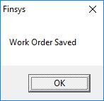
Alert !!

Slide 43
Print of the Machine Loading Card

Slide 44
Edit WO

Slide 45
Production Time

Slide 46
Store Issues the Material

Slide 47
Stores issue

Slide 50
Just in case

Slide 52
Cannot issue more than request

Slide 53
Given 328

Slide 55
Paper Cutting

Slide 57
Cut done, yes

Slide 59
The jobs planned come here for that machine only

Slide 61
Operator, time

Slide 62
Each job, even the sequence

Slide 63
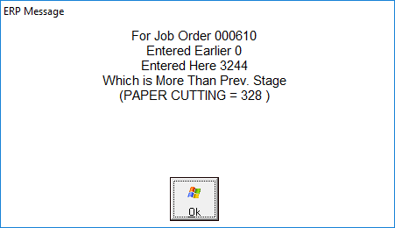

Slide 64
Qnty auto changed

Slide 66
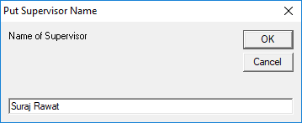
Mark Job as Closed … which supervisor says so ?

Slide 68
Machine Down Time Reasons ?

Slide 70
Item Stage linking
Now, we do the E-Fluting

Slide 72
Plan and give instructions to other sections

Slide 75
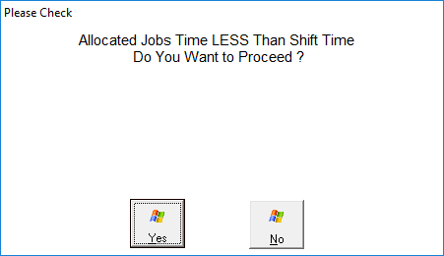

Slide 77
WO updation entry

Slide 82
Dashboard

Slide 84
Which stage, when, who,

Slide 85
And so on…..

Slide 86
Last stage, sorting packing

Slide 88
Who packed, who sorted

Slide 91
DPR

Slide 93
PPM and reason wise analysis

