Slide 1
Blow moulding Machine for PET Bottles

Slide 2
Purpose :

Slide 3
Machines available for 1 to 12 cavities, to make upto 12000 bph ( bottles per hour )

Slide 4
Your Bottles are ready

Slide 5
Now the Question is, how Finsys ERP helps in managing the production of the Pet Bottles ?

Slide 6
First create the “Machine” = Stretch BMM created

Slide 7
Production capacity , cycle time defined

Slide 8
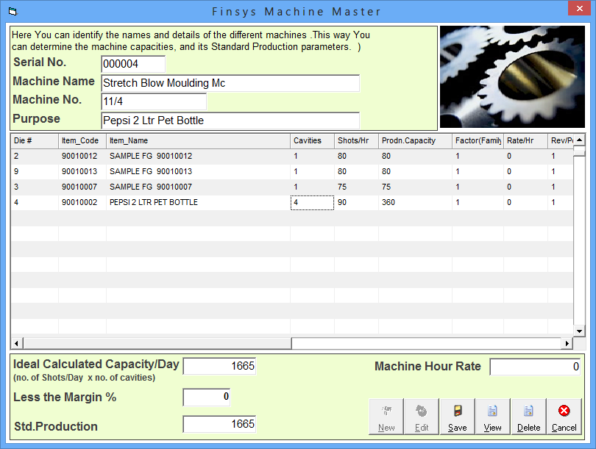

Slide 9
Now over to manufacturing

Slide 11
First stage production

Slide 12
Which shift, which machine ?

Slide 13
Which item / mould today

Slide 14
Who was the operator today ?

Slide 15
Production remarks

Slide 16
How many cavities running ?

Slide 17
Defect – reason wise analysis ?

Slide 18
Other problems ..

Slide 19
Actual shots ? 901 as per machine meter

Slide 20
Why was the production short ?

Slide 21
Machine down time reasons ?

Slide 22
Still not reconciled … till then sorry !! Can’t save

